Slide 1
Avionics, GNC and SW Systems Review for LEAPFROG GEN II
Requirements:
LEAPFROG GEN II Flight Requirements
Competition Requirements
Avionics Requirements
GNC Requirements
Software Requirements
System Overview and Architecture Definition
CONOPS for Flight
Top Level Performance Specs
Avionics
Engine system
GNC Specifics
System Details
Avionics Details
GNC Details
Software Details
Competition Simulation and Flight Operation Definitions
Notes:
Add abort codes or mission variables, test scenarios..
<number>

Slide 2
Primary Flight Requirements for LEAPFROG
Flight Goals:
>2.5 meters in height
10 second to 60 second max flight duration
Stability in roll, pitch, and yaw during hover and translation (+/- 0.5 deg)
Control over altitude (+/- 0.5 meter)
Active abort contingencies
Off-Board Goals:
Ground control authority
Command override authority during flight from Ground
Turnaround of LEAPFROG flight to flight within 15 minutes
Analysis of accuracy and efficiency of system components
Notes:
Add abort codes or mission variables, test scenarios..
<number>

Slide 3
Artemis LEAPFROG Competition Requirements (Belzberg et al)
Goals
Provide off-board remote capability for teams to develop flight algorithms using LEAFPROG components
Provide them basics on vehicle dynamics, characteristics, sensor capabilities
Tie the software pre-flight challenge, to the flight challenge
Implementation Recommendations
Fly a separate COTS based microprocessor that can be purchased by any/all teams (PixHawk)
Develop onboard LEAP an override function that continues nominal flight to land, if the competition team code or flight algorithms are off-nominal
Provide competition teams specific limits on key variables:
Altitude
Altitude rate
X, Y field location limits (Geo Fence)
Velocity of vehicle
Angle of Gimbal commanded

Slide 4
Gen II Avionics Requirements (Antariksh)
Hardware Requirements
Sensors calibration and library
Stabilization: IMU (MPU6050)
Attitude control: LiDAR (SEN0259)
Resource status
Fuel: estimation
Cold gas: pressure sensor
Navigation: PixHawk (Controller + GPS)
Processors
Main Controller : Raspberry Pi
Navigation Controller : PixHawk
Telemetry system for downlink of real time flight data, and uplink “heartbeat” for safety override
Engine Controller for Jet Engine
Relay Controller for ACS Thrusters
Sufficient Power system for all primary and secondary devices, with sufficient margin for Flight
Software requirements
Ground Operations Mode for startup, checkout, and override
Mission Mode (flight profile insertion, autonomous flight, safety overrides)
Flight Information (health and safety and status of all systems)

Slide 5
GNC Requirements
Establish two methods to support Stabilization and Translation for LEAPFROG
Primary Stabilization through Cold Gas Thrusters as Attitude Control
Primary Translation using Thrust Vector Control (TVC) with a gimbaled Jet Engine
Backup Stabiliization
Each operates independent of the other, but each can provide for some level of stability in emergencies
For the Simulation and Flight Challenge, competitors will only program inputs to the TVC and Engine system
The ACS system is independent and meant to be failsafe

Slide 6
Software Requirements
TBD

Slide 7
System Architecture (Dave b)
CONOPS
Full Systems Functional Layout
GNC System functional Layout
ACS System functional layout
TVC System Functional Layout
S/W Flow diagram
Power System Functional Layout
Must combine the following charts into something that is consistent with each other, and makes it easy to trace from hardware, to function etc.

Slide 8



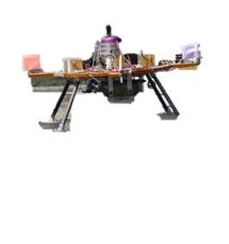
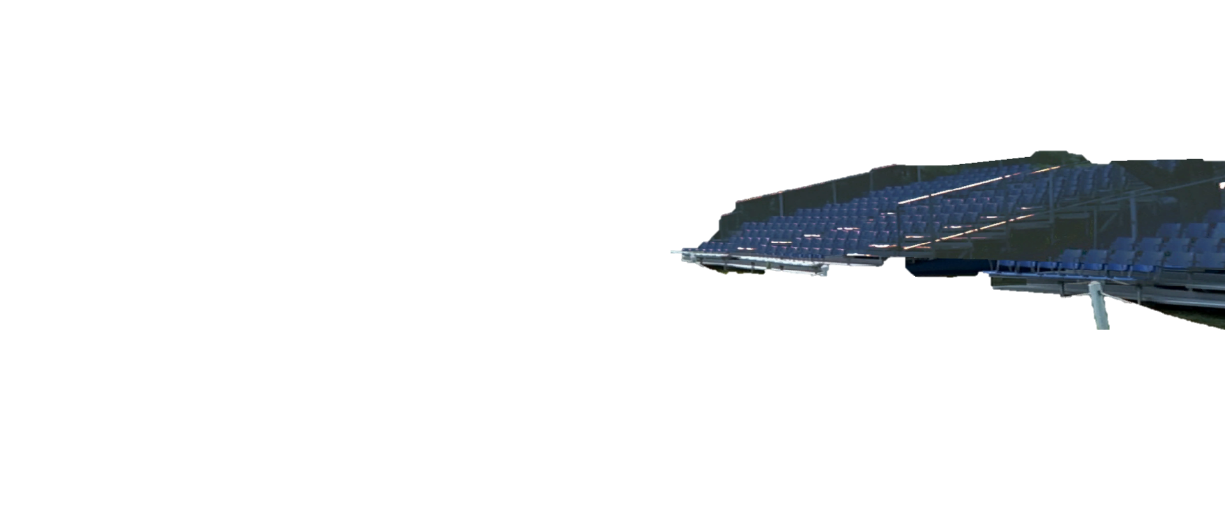
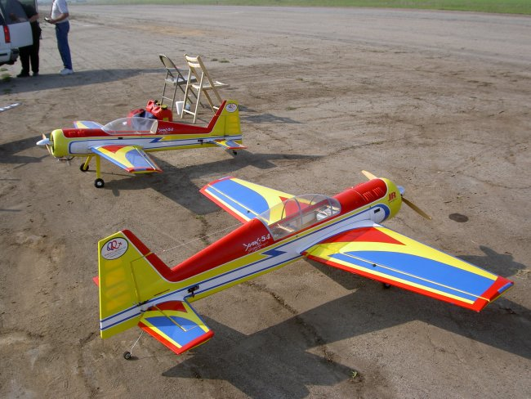
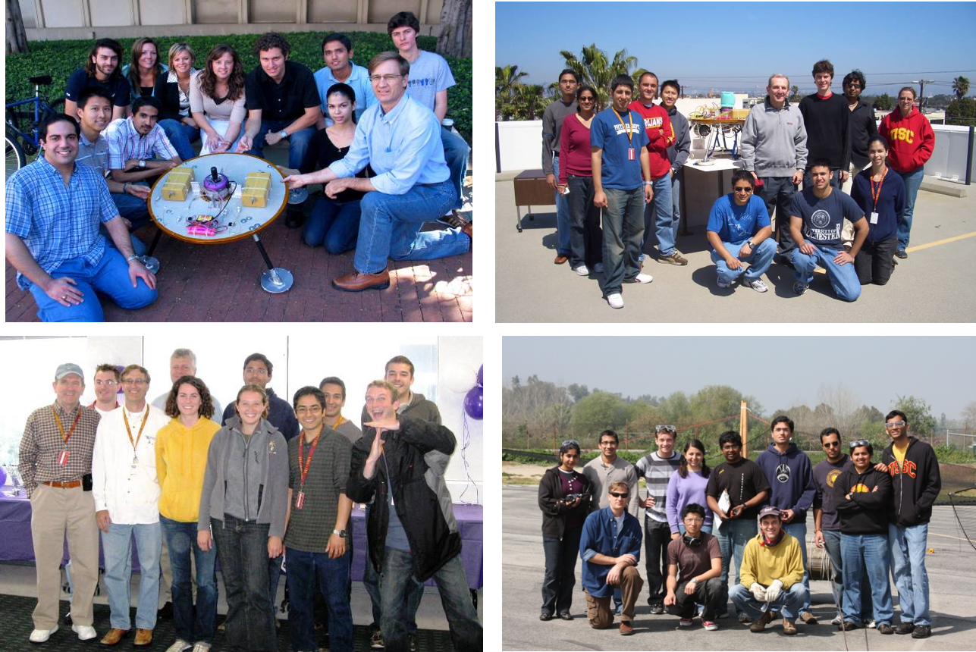
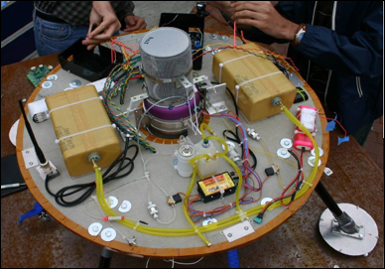
CONOPS for Flight Competition (Daniel/Thanh et al)
LEAPFROG Operations Center:
Up to 500 meter range
Possible Competition Metrics:
Fuel Useage
Multi-Hop Translation
Various Guidance Challenges
Etc
Flight Time
Stability and Hold
Navigation Precision
RC Airfield provides T/O and Landing Sites
Wireless signal booster
RC Field supports Audience Member Viewing Stands for public involvement
Laptop Control
Competition Field uses RC Fields
RC Airplane Pits: LEAPFROG Fueling and Pre-Flight C/O
LEAPFROG Sets up PostFlight Assessment and Scoring

Slide 9
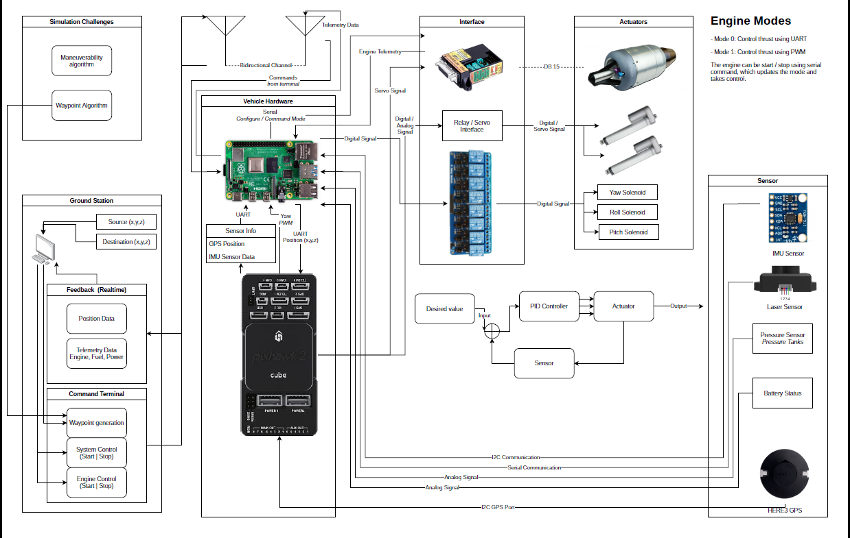
System Block Diagram

Slide 10
Ground
Power
Lander
LiIon Charger
Power Distribution Unit
C&DH
ACS
586D Controller
D/A Board
12 PLC or Relays
12V
P/L
Solenoids
22V
Ground Power
Camera
P/L
Cam Antenna
Comm
Ground Computer
(Thinkpad)
Camera Interface
Wireless
H&S Antenna
GNC
5V
Payload Antenna
3 MEMS Gyros
Payload Antenna
3.3V
H&S Antenna
3 MEMS Accels
Jet Prop.
4 Gimbal Motors
5V
Altimeter
9V
Fuel Shutoff
12V
Ground Jet
Controller
ECU
Propane Shut off
Jet Pump
Jet Engine
Kristina Rojdev
Dec 03, 2007

Slide 11
Software Architecture
TBD

Slide 12
System Overview
ACS
ODRIOD
Solenoid
Feedback Sensors
ACS Controller
Pitch
Roll
Demodulator
Yaw
TVC
Pixhawk Cube
PX4
Gimbal
Pos/Att Estimator
ECU
Jet Engine
Navigator
Position Controller
Mixer

Slide 13
TVC
Ground Control Station
QGroundControl
People/Path Planning Software
Legend For Arrows:
Waypoints/constraints/parameters
Sensor/position feedback
Position setpoints
Attitude and thrust setpoints
Thrust setpoint
Commands for actuators
Feedback Sensors
Pixhawk Cube
PX4
Gimbal
Pos/Att Estimator
ECU
Jet Engine
Navigator
Position Controller
Mixer

Slide 14
Links:
Documentation for uploading the firmware onto the vehicle: https://docs.px4.io/master/en/config/firmware.html
PX4 Controller Diagrams: https://dev.px4.io/master/en/flight_stack/controller_diagrams.html
Estimation/Localization library documentation: https://docs.px4.io/master/en/advanced_config/tuning_the_ecl_ekf.html

Slide 15
ACS
ODRIOD
Feedback Sensors
Solenoid
ACS Controller
Pitch
Roll
Pixhawk
Demodulator
Yaw
PX4
Legend For Arrows:
Sensor feedback
Duty cycle for pitch and roll cold gas thrusters/relays/solenoids
PWM corresponding to the yaw force desired
Duty cycle for yaw cold gas thrusters/relays/solenoids

Slide 16
ACS
ACS Controller
Standard PID Controller With Low-Pass Filter on D Term
Force to Duty Cycle Conversion Estimator
Attitude Feedback
Duty Cycle

Slide 17
Power System layout
Jet Engine
24V
Relays
12 solenoids
Camera
7.2V
Avionics Computer
Opto-isolator
D/A
Power Amp
Gimbal Motors
IMU
LDO regulator
Altimeter
6V
Red lines are power lines and black lines are signal lines. Ground and voltage lines have not been specified.

Slide 18
Detailed Systems Definitions
Avionics & Wireless System
GNC
Engine
Note what follows are examples of the kind of information that should be included in various sections

Slide 19
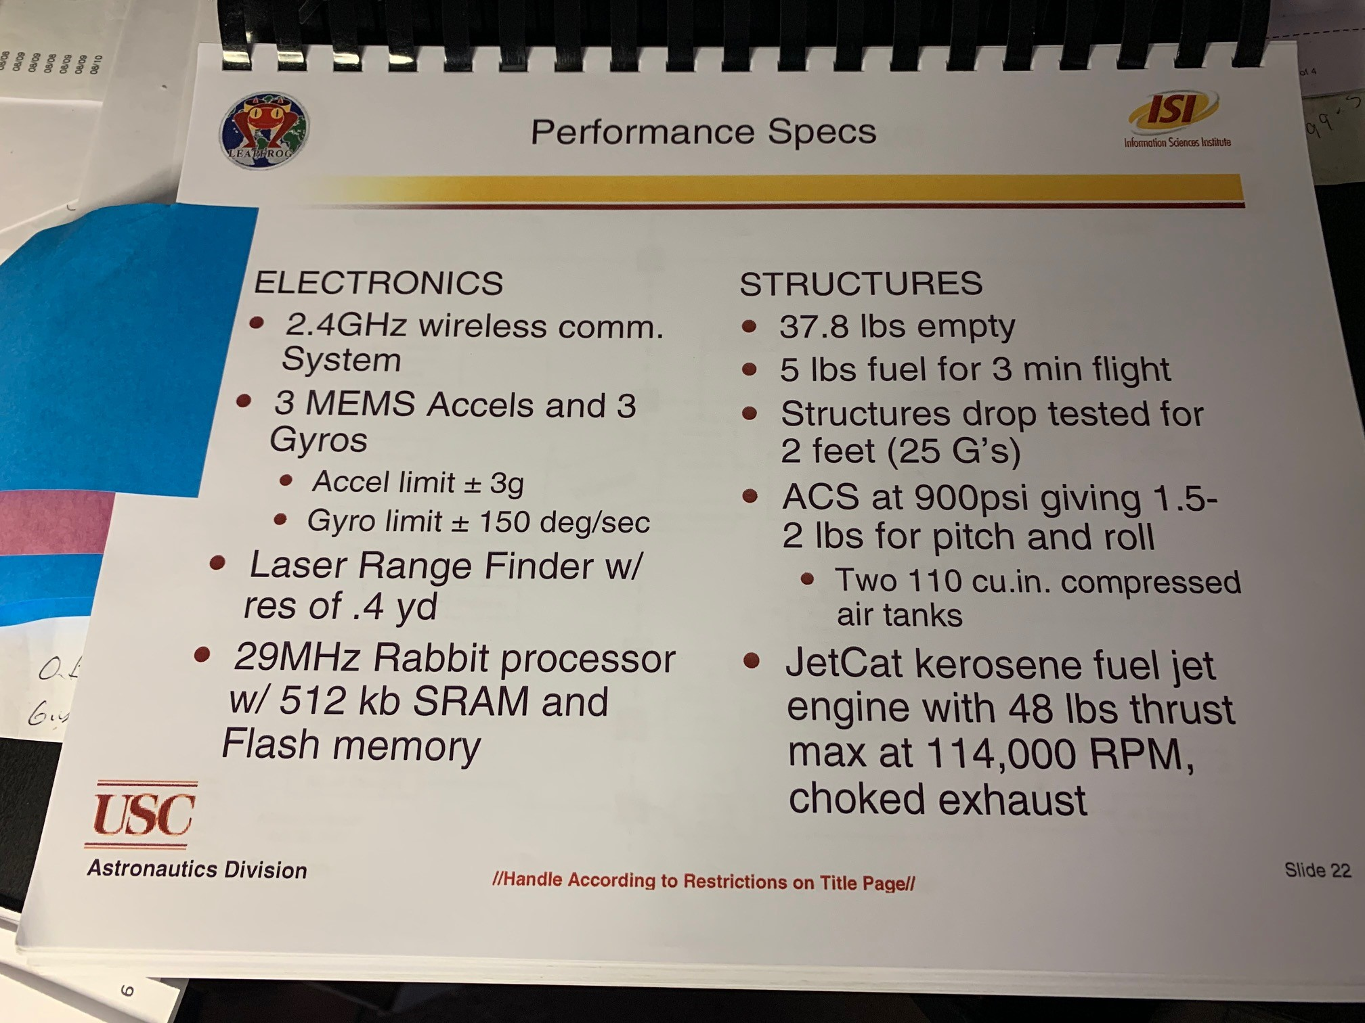
Top Level Performance Specs (can be actual hdwe specs or not)
Antarkish for electronics
Michael S for vehicle structure
Kendra for ACS System
TBD for Jet Engine System

Slide 20
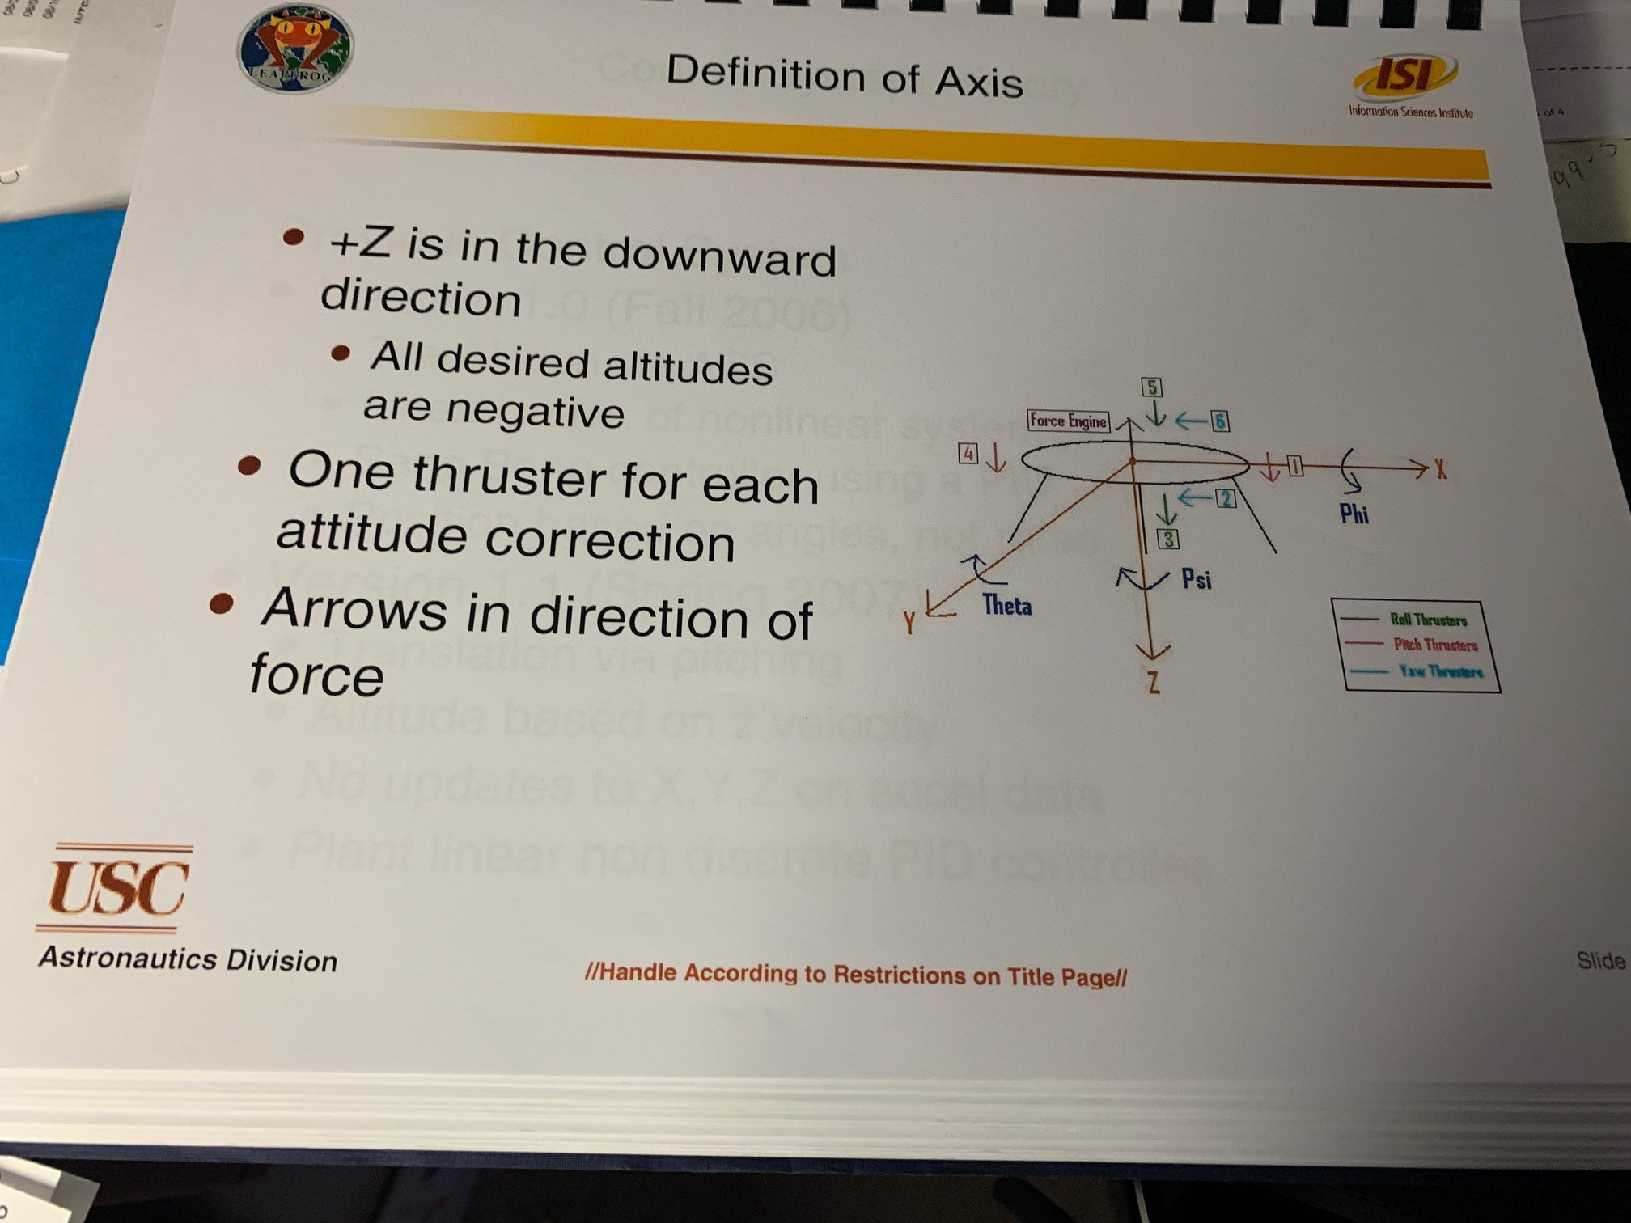
Common Flight Axes definitions for Code and hdwe orientation
Andrew

Slide 21
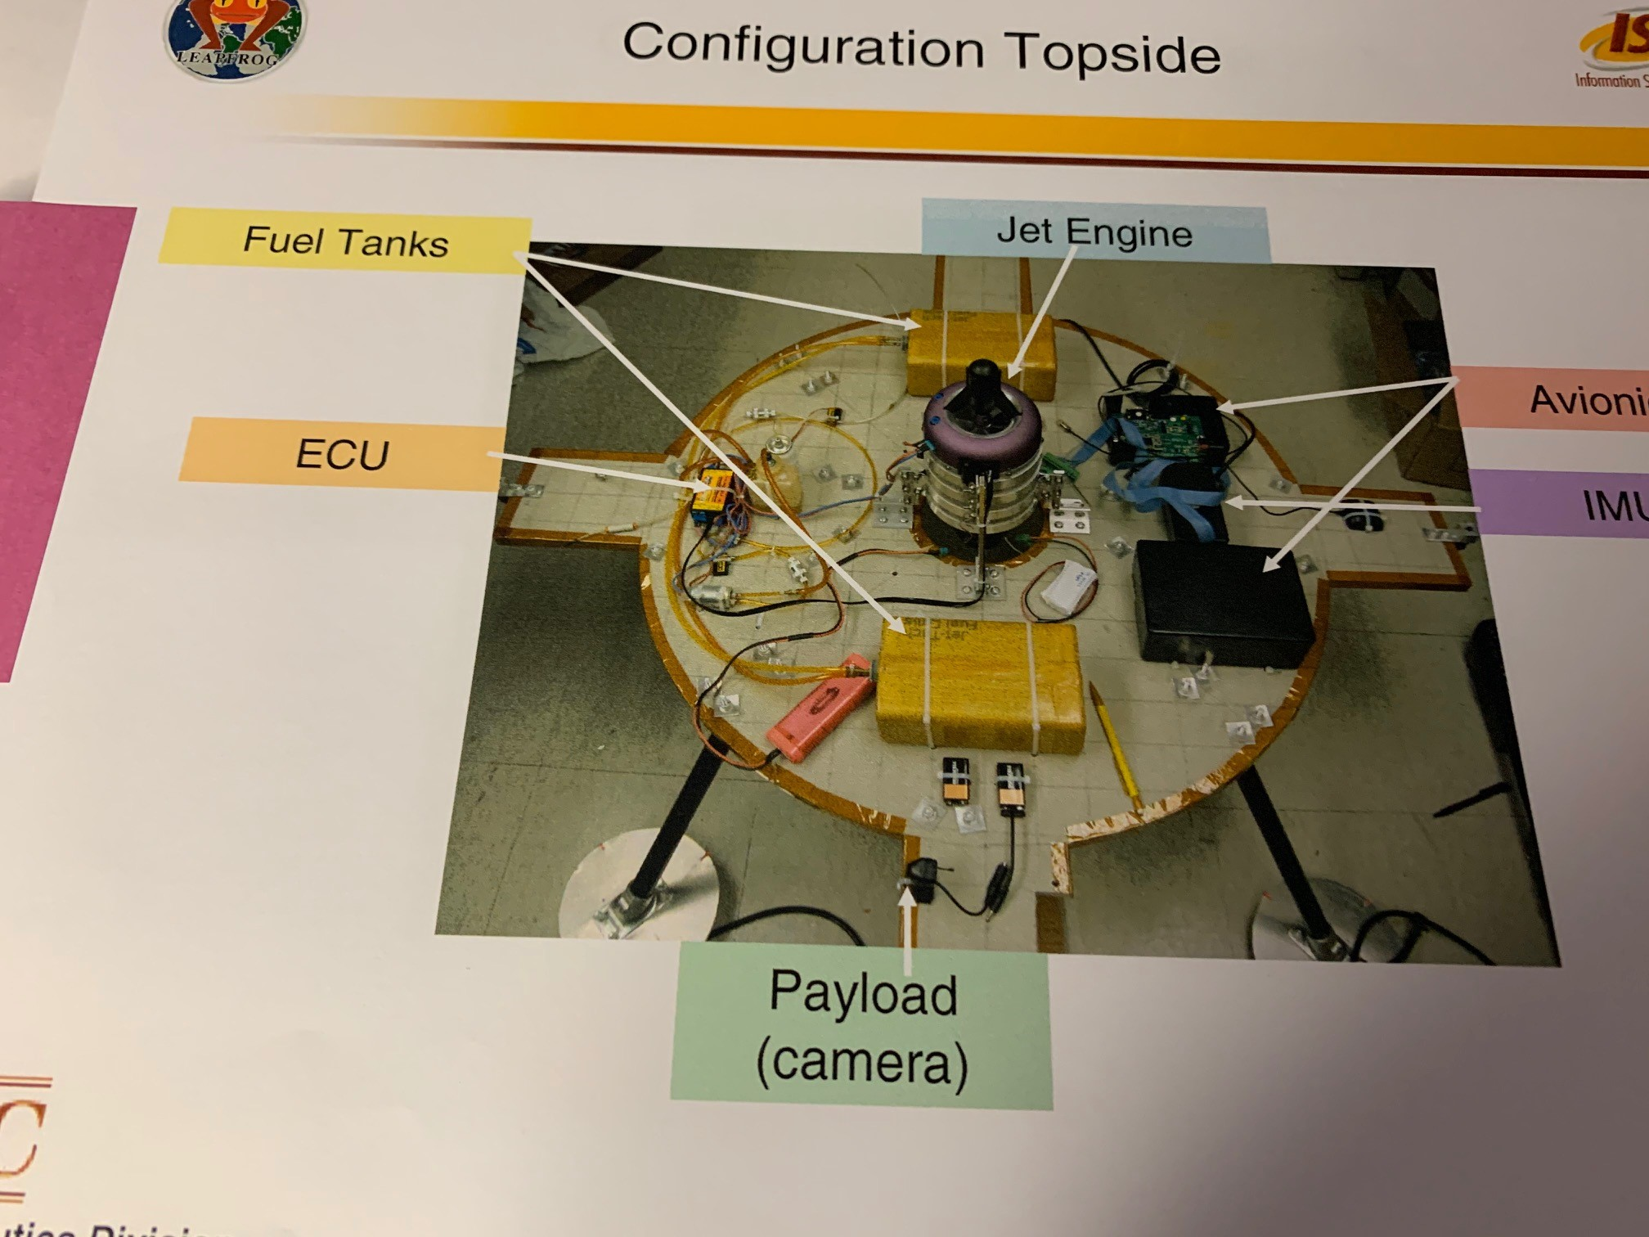
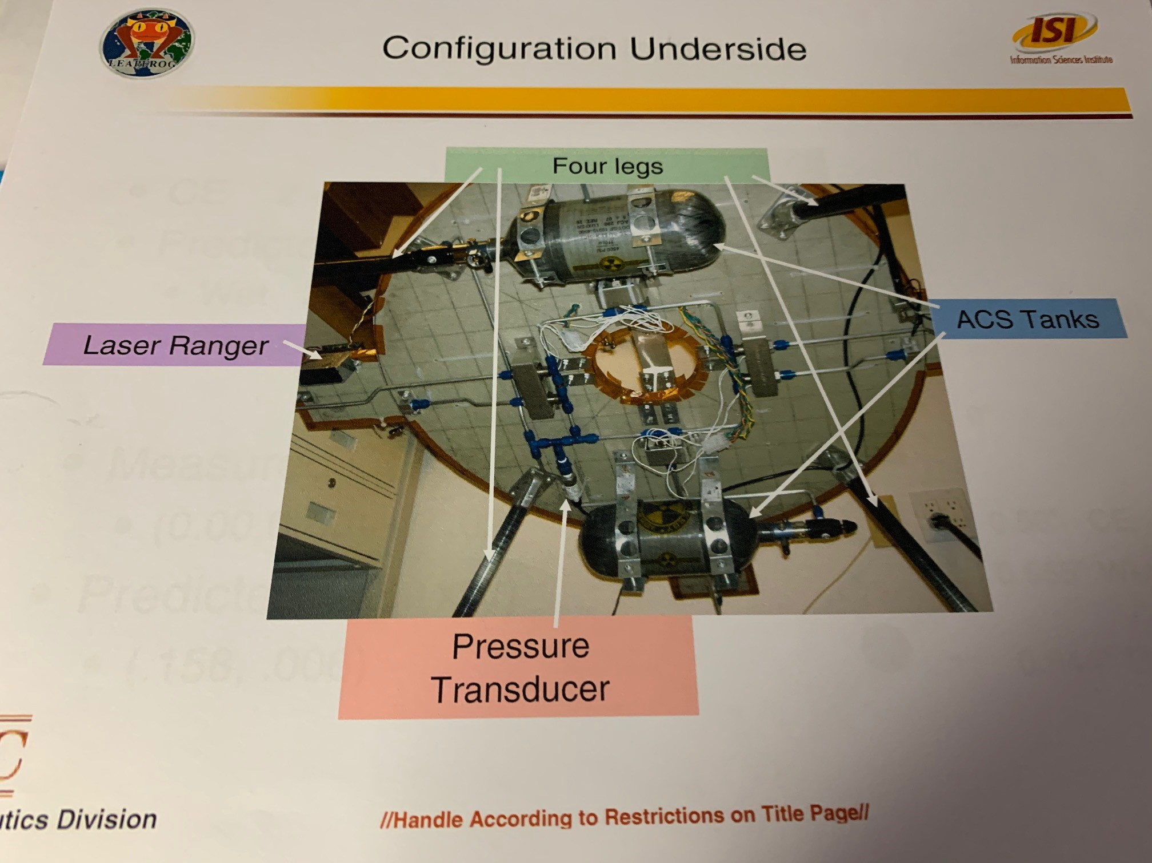
Layout of Hardware (either actual photo or CAD, doesn’t matter
Michael et al

Slide 22
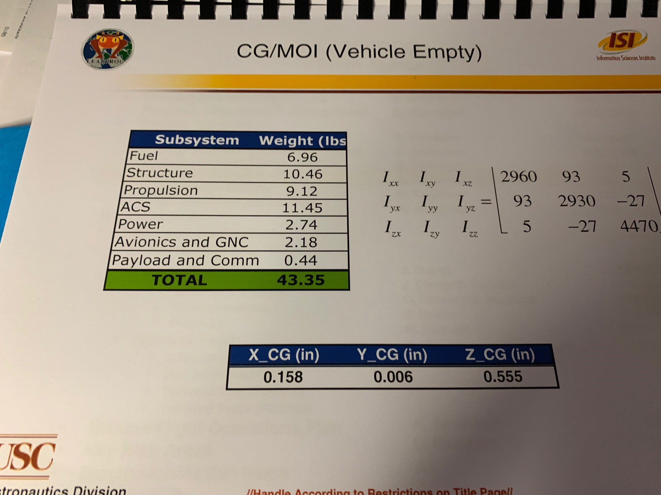
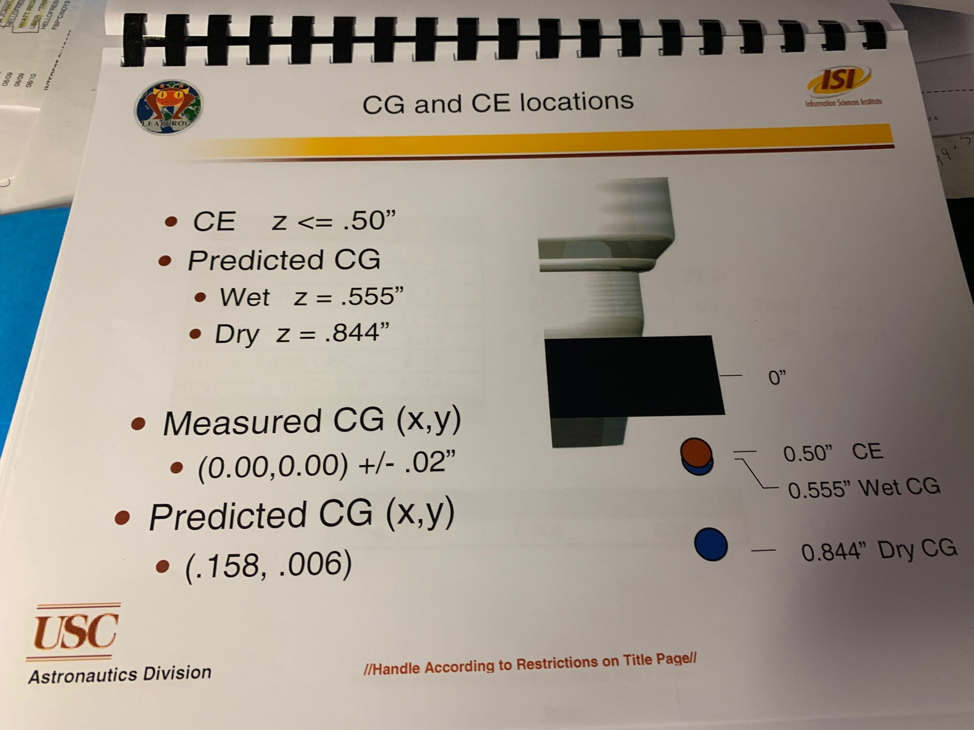
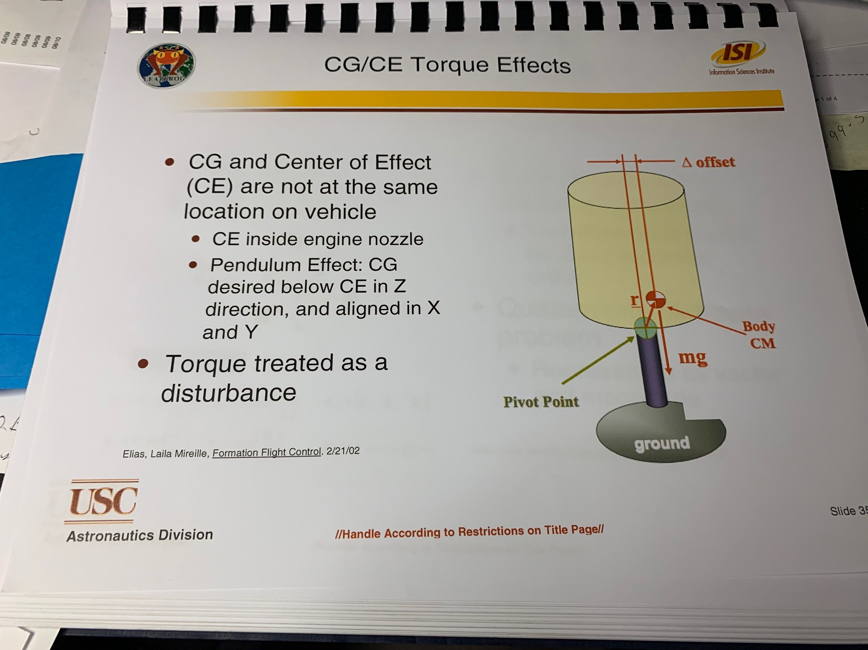
Define CG/MOI/CE Location/Effects etc
Michael/Andrew

Slide 23
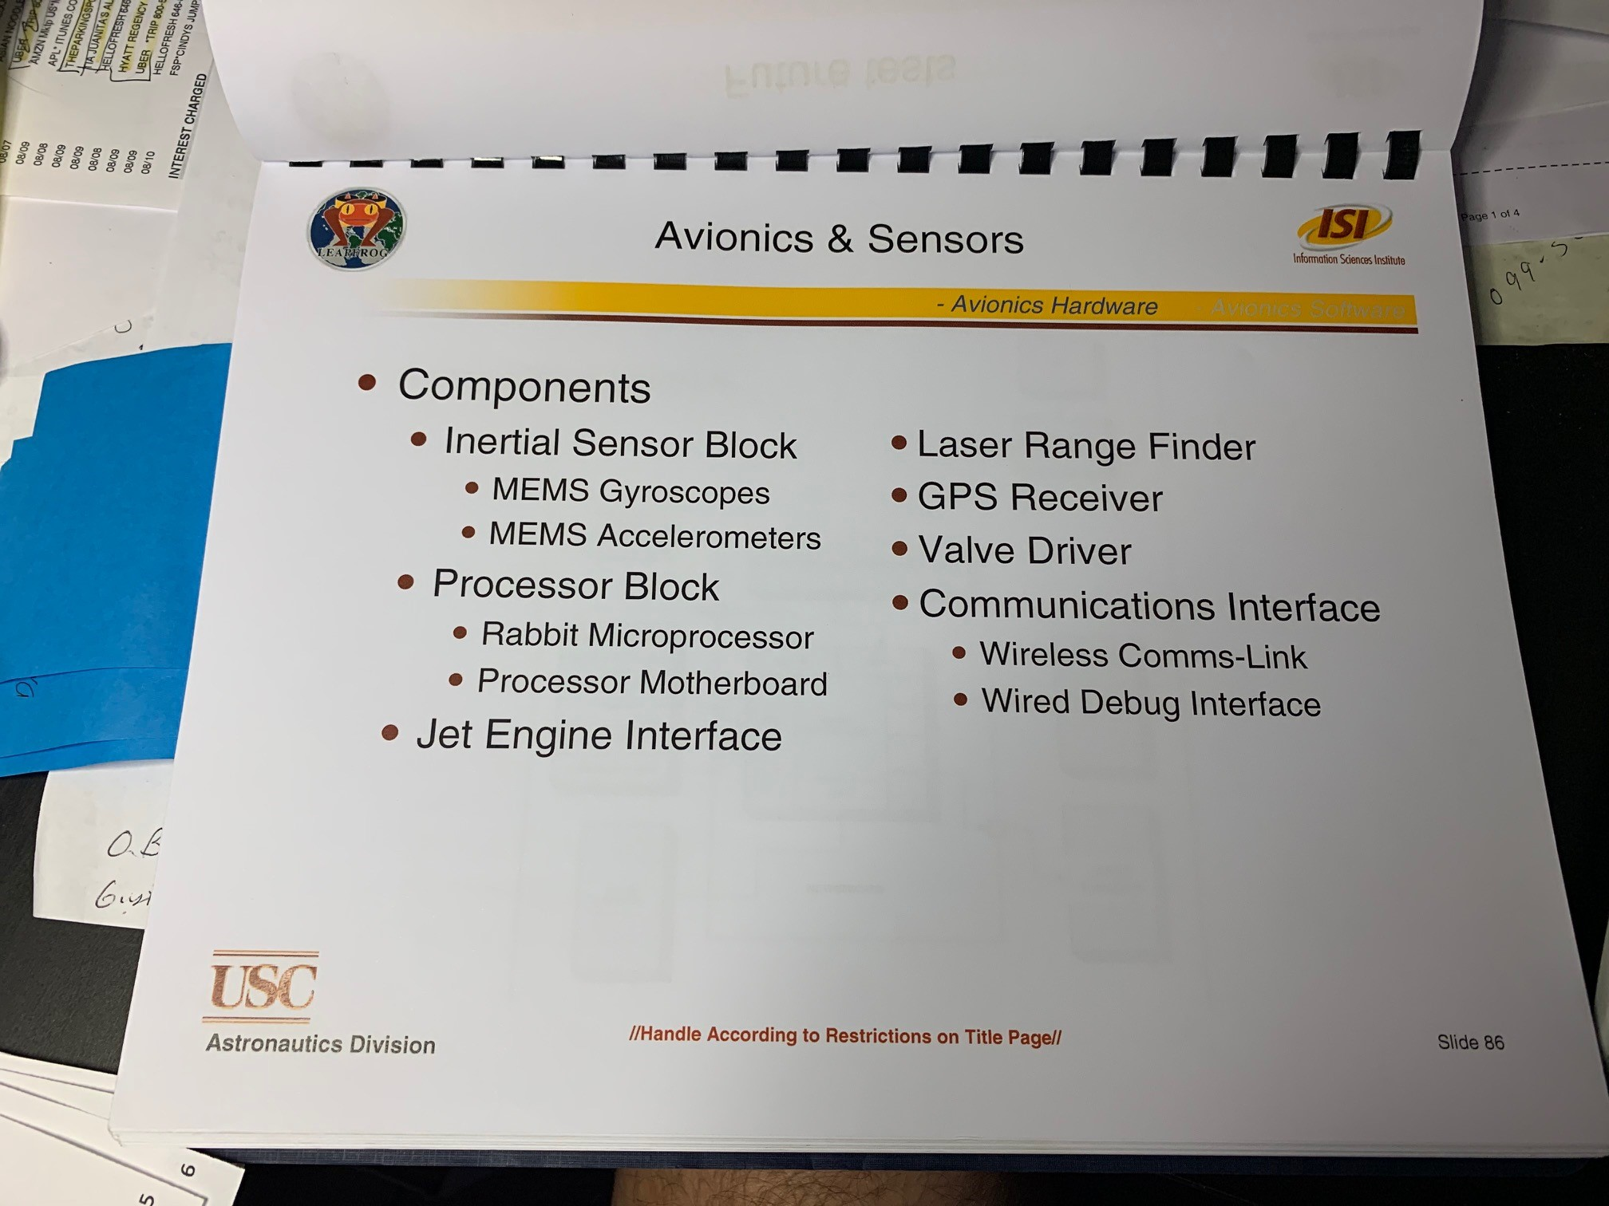
Avionics and Wireless Systems
Antariksh

Slide 24
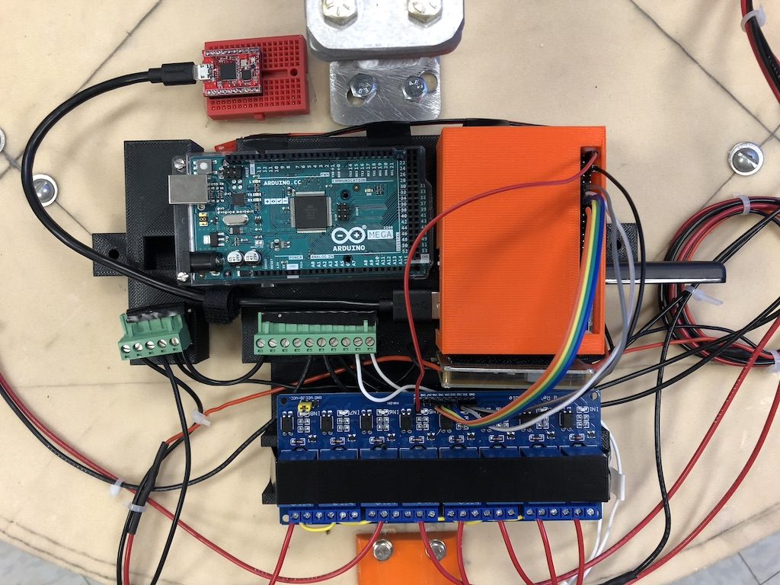
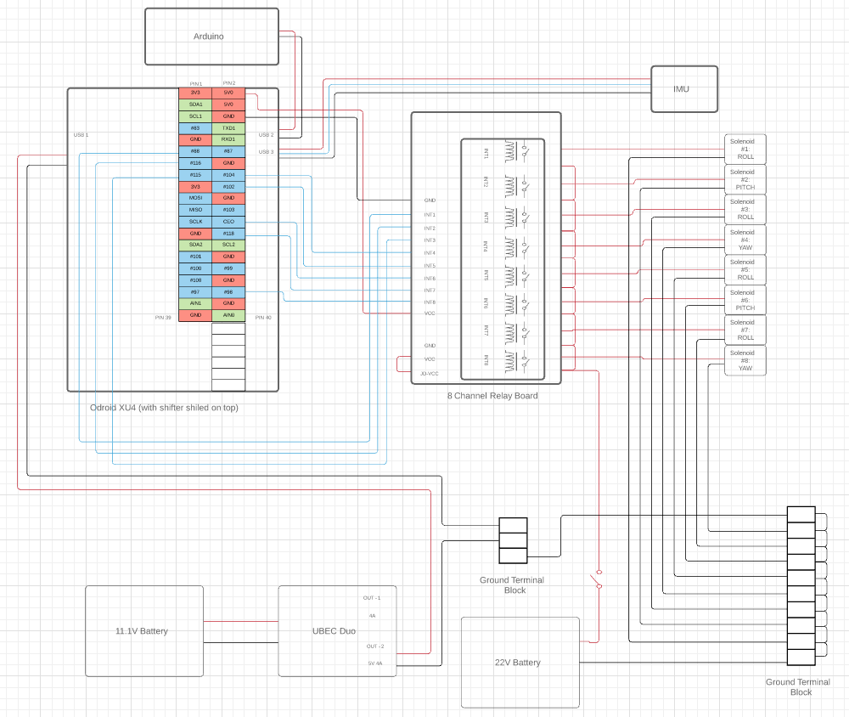
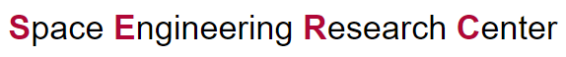
Avionics uses COTS Processor(s)
Current Circuit Design
IMU
Odroid XU4
Grounding Blocks
Relay Board
11/10/2020
<number>
Notes:
How is the data from the MCU consumed by the Gimbal
<number>

Slide 25
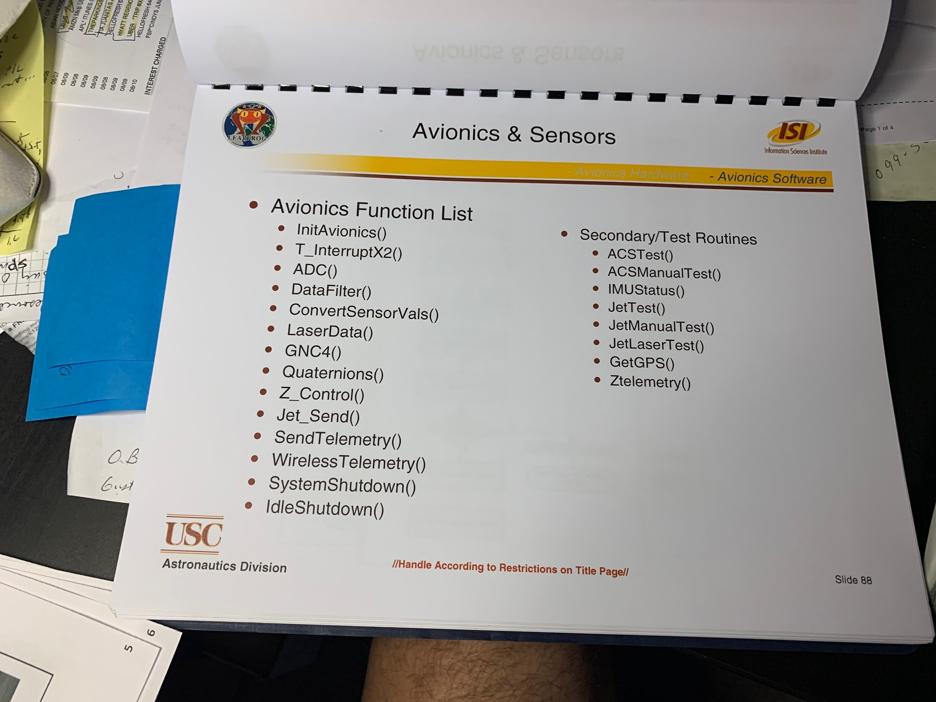
Avionics Primary function list (can be pseudo commands, but list of what you need the avionics to do)
Antariksh

Slide 26
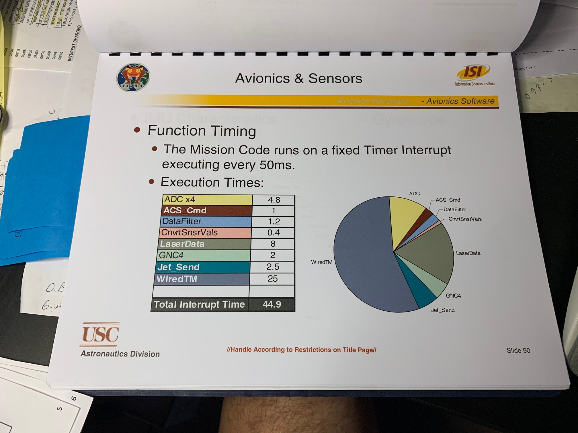
Avionics Timing of functions…
Antariksh

Slide 27
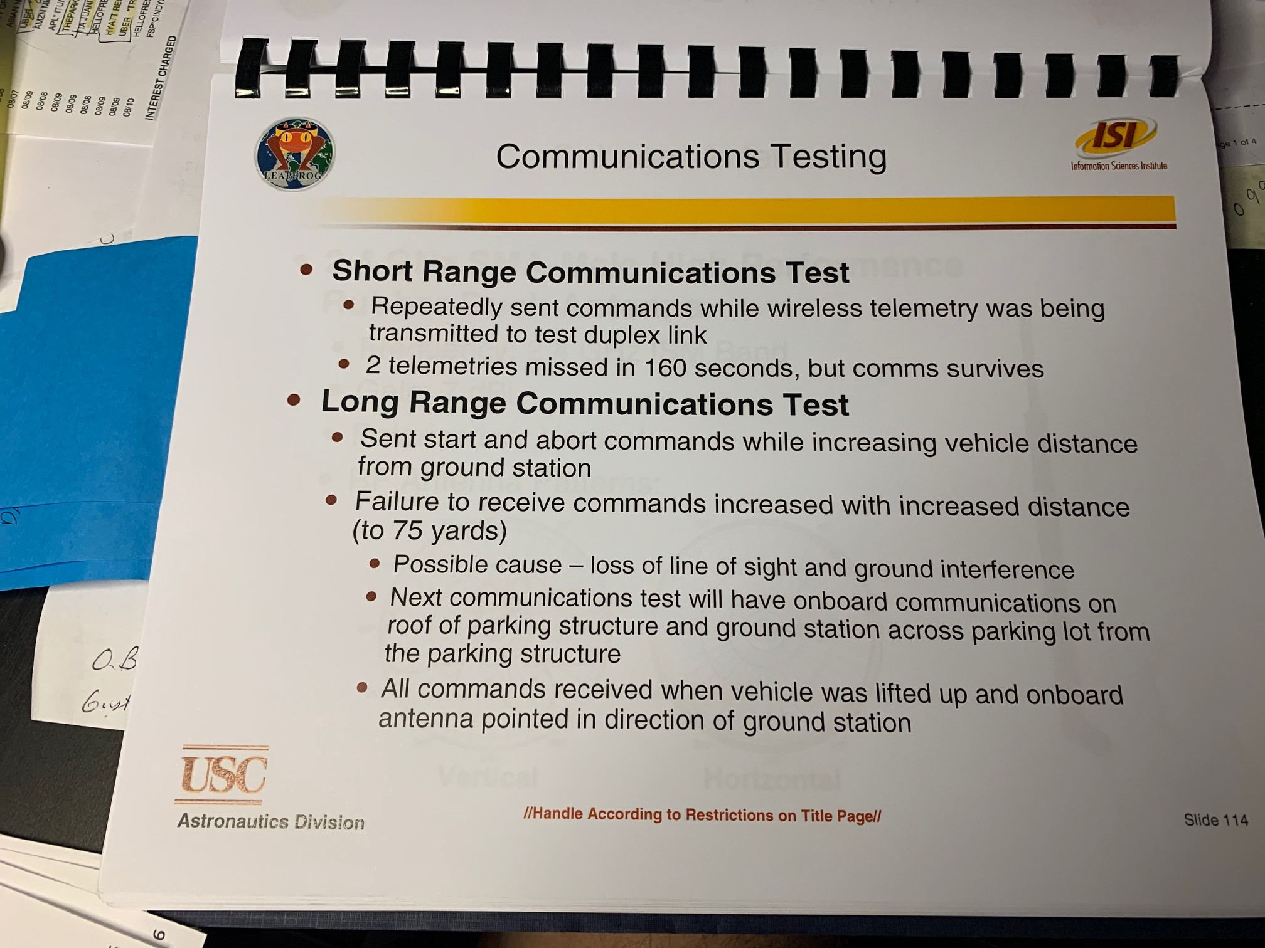
Wireless System Requirements
Antariksh/Daniel

Slide 28
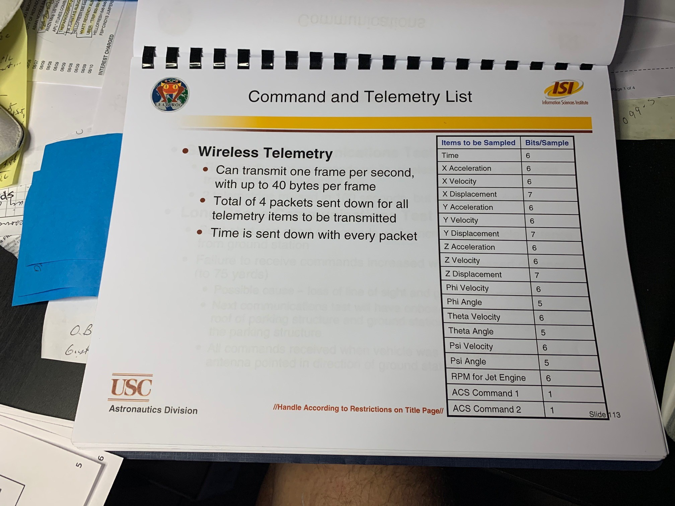
Command and Telemetry List (Antariksh + ?)
What does the wireless link have to send up and down to the vehicle

Slide 29
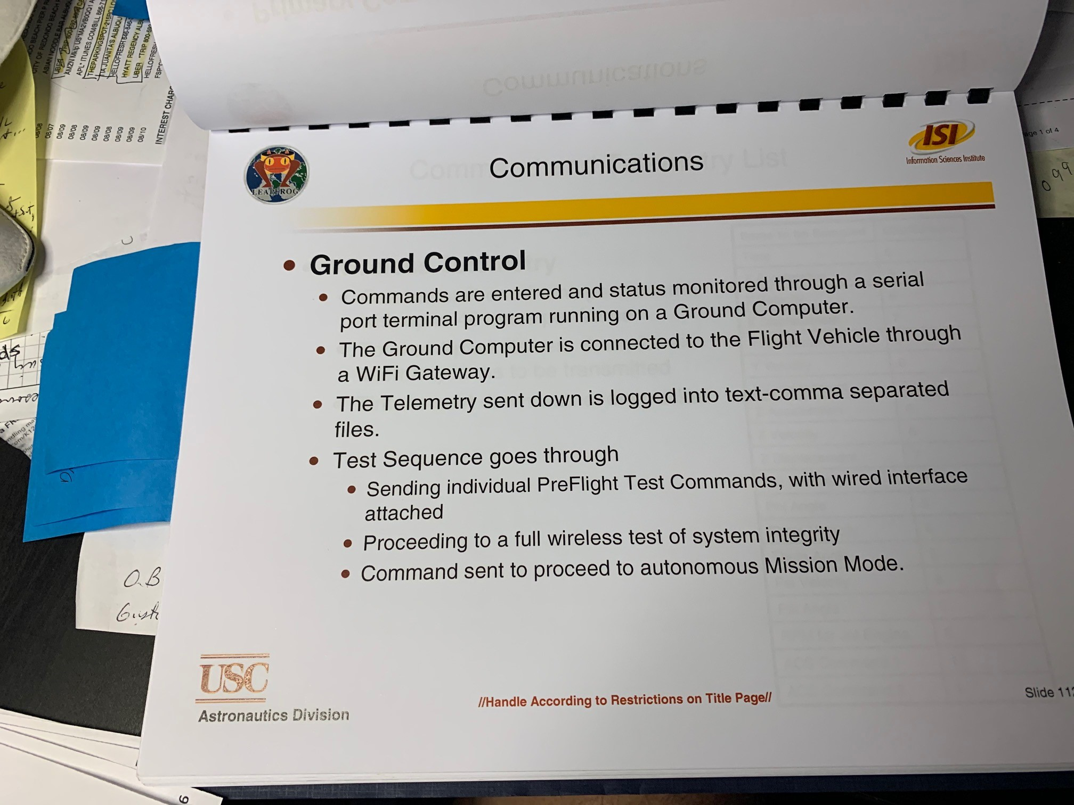
Ground Control for Communications (Antariksh)
What does it have to do?

Slide 30
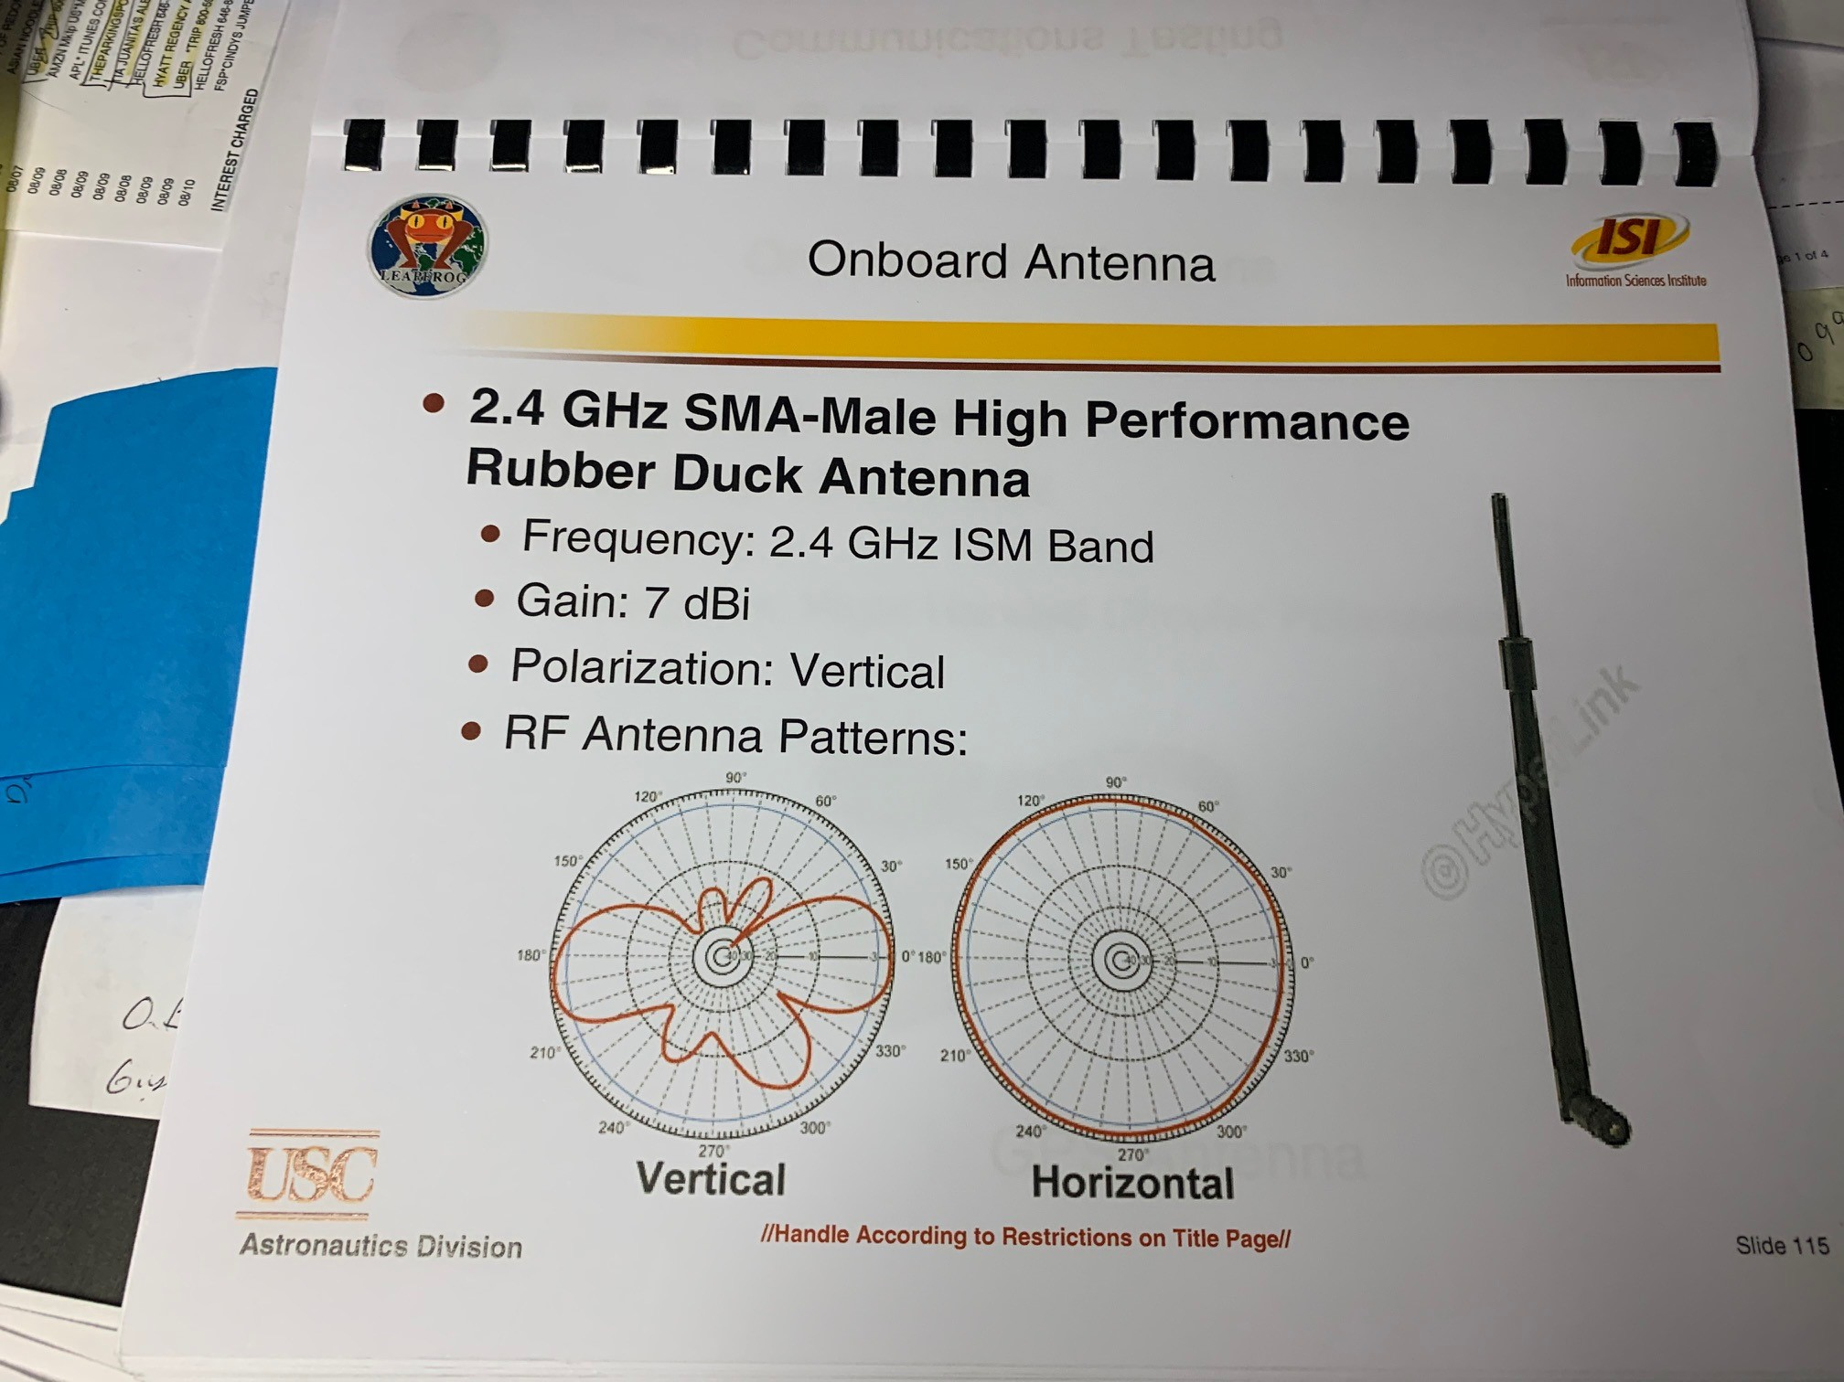
Wireless components (Antariksh)
Show transmitter and antenna, validates it will work on larger range

Slide 31
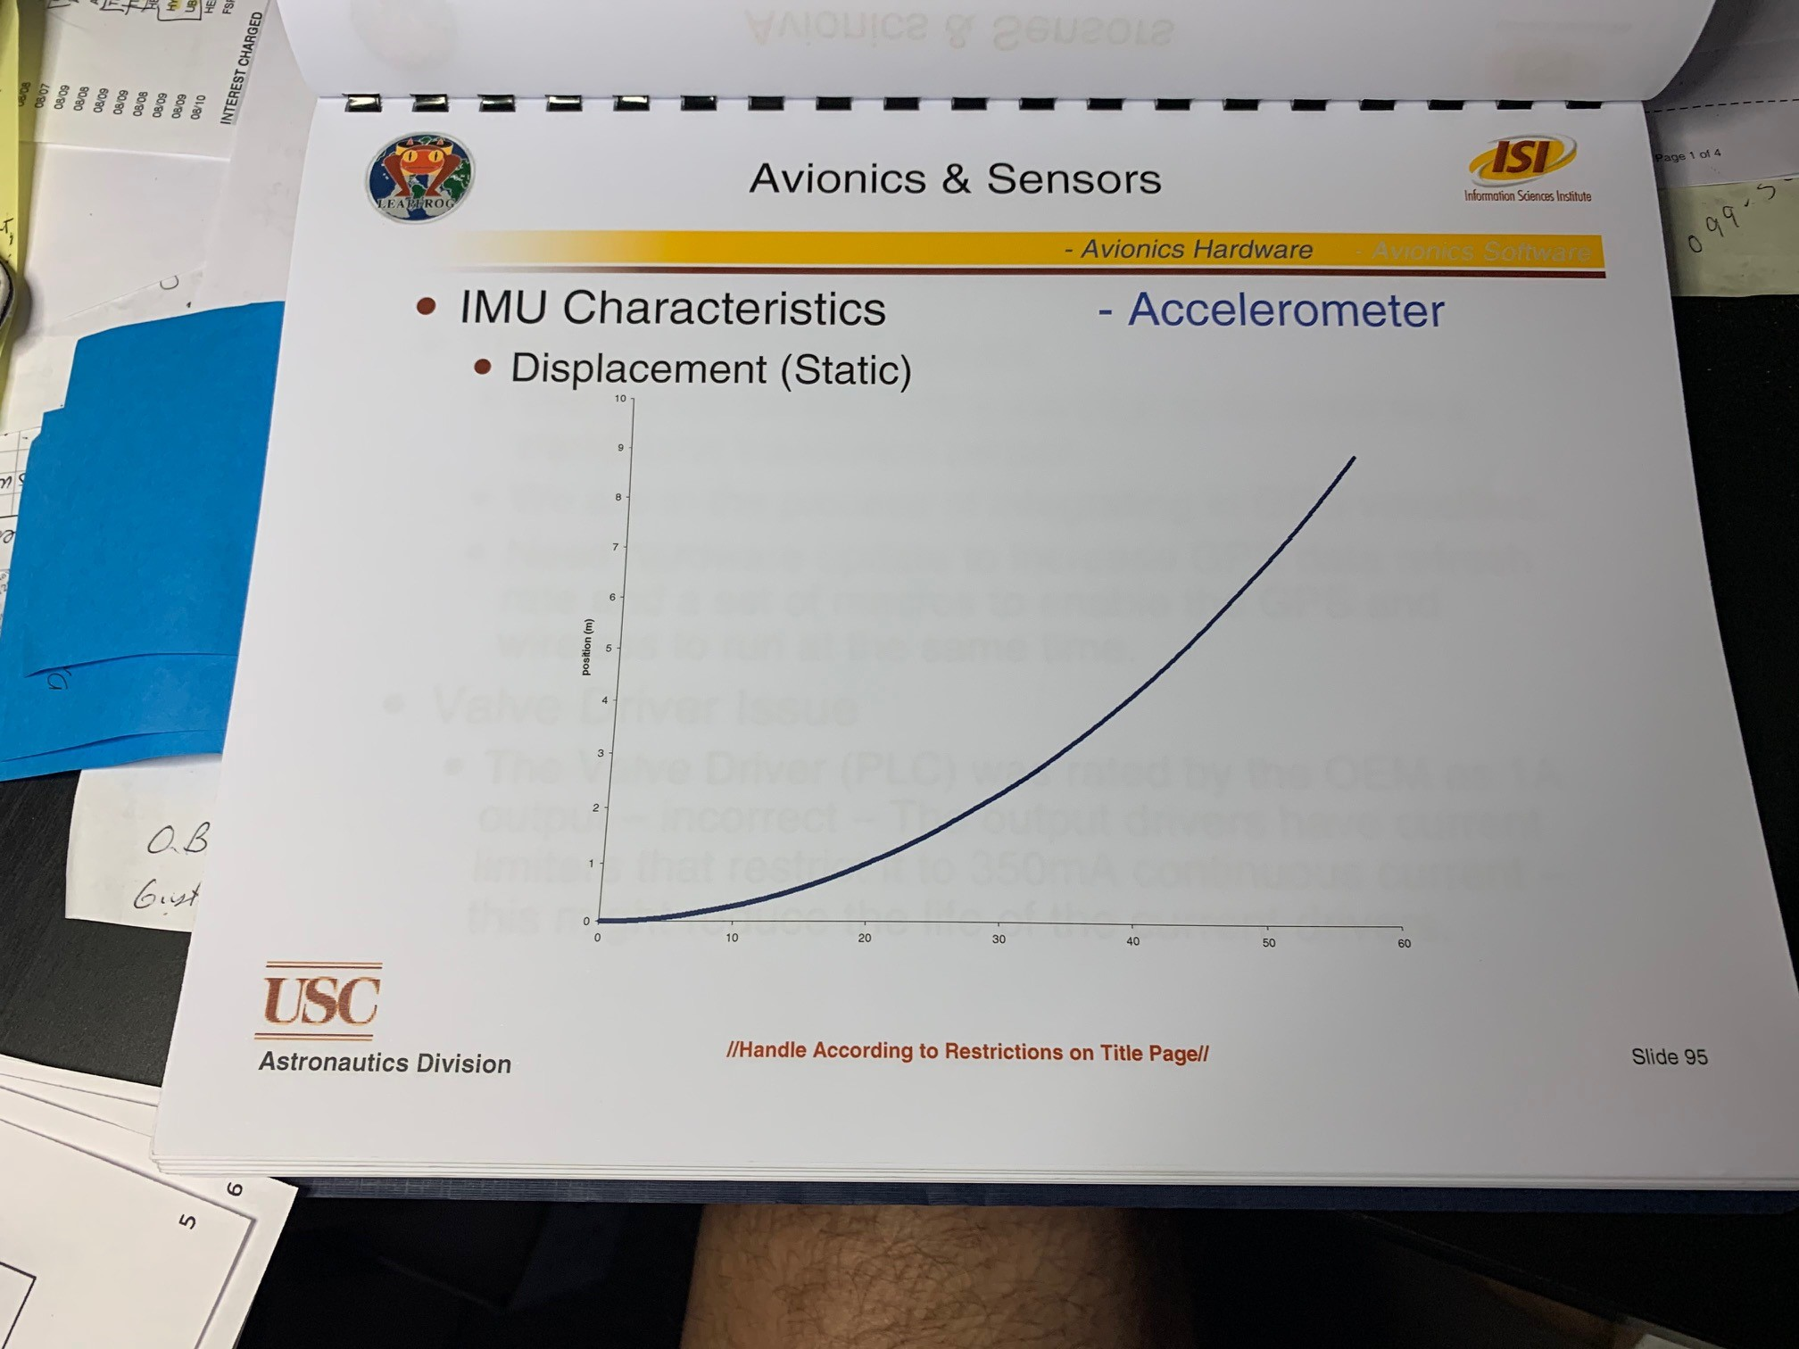
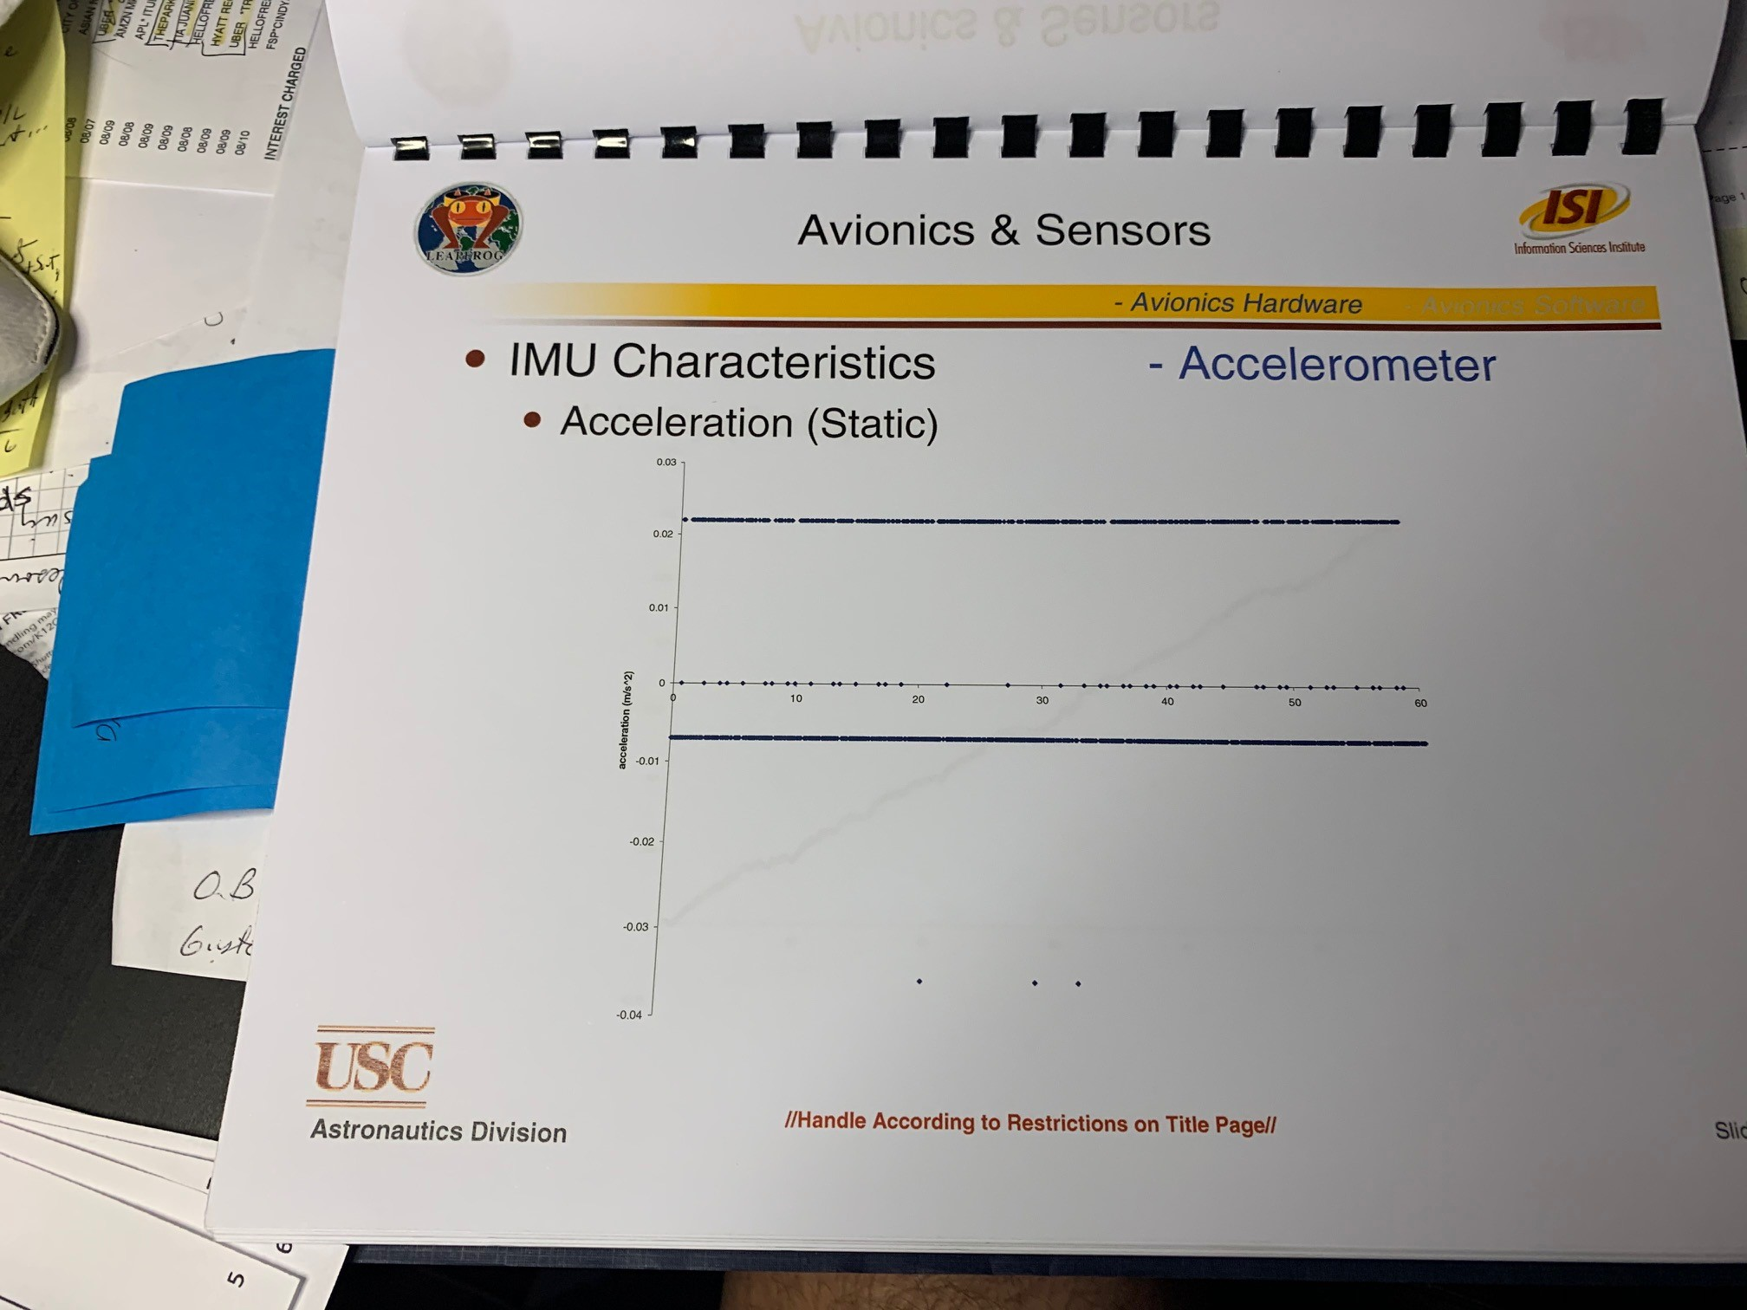
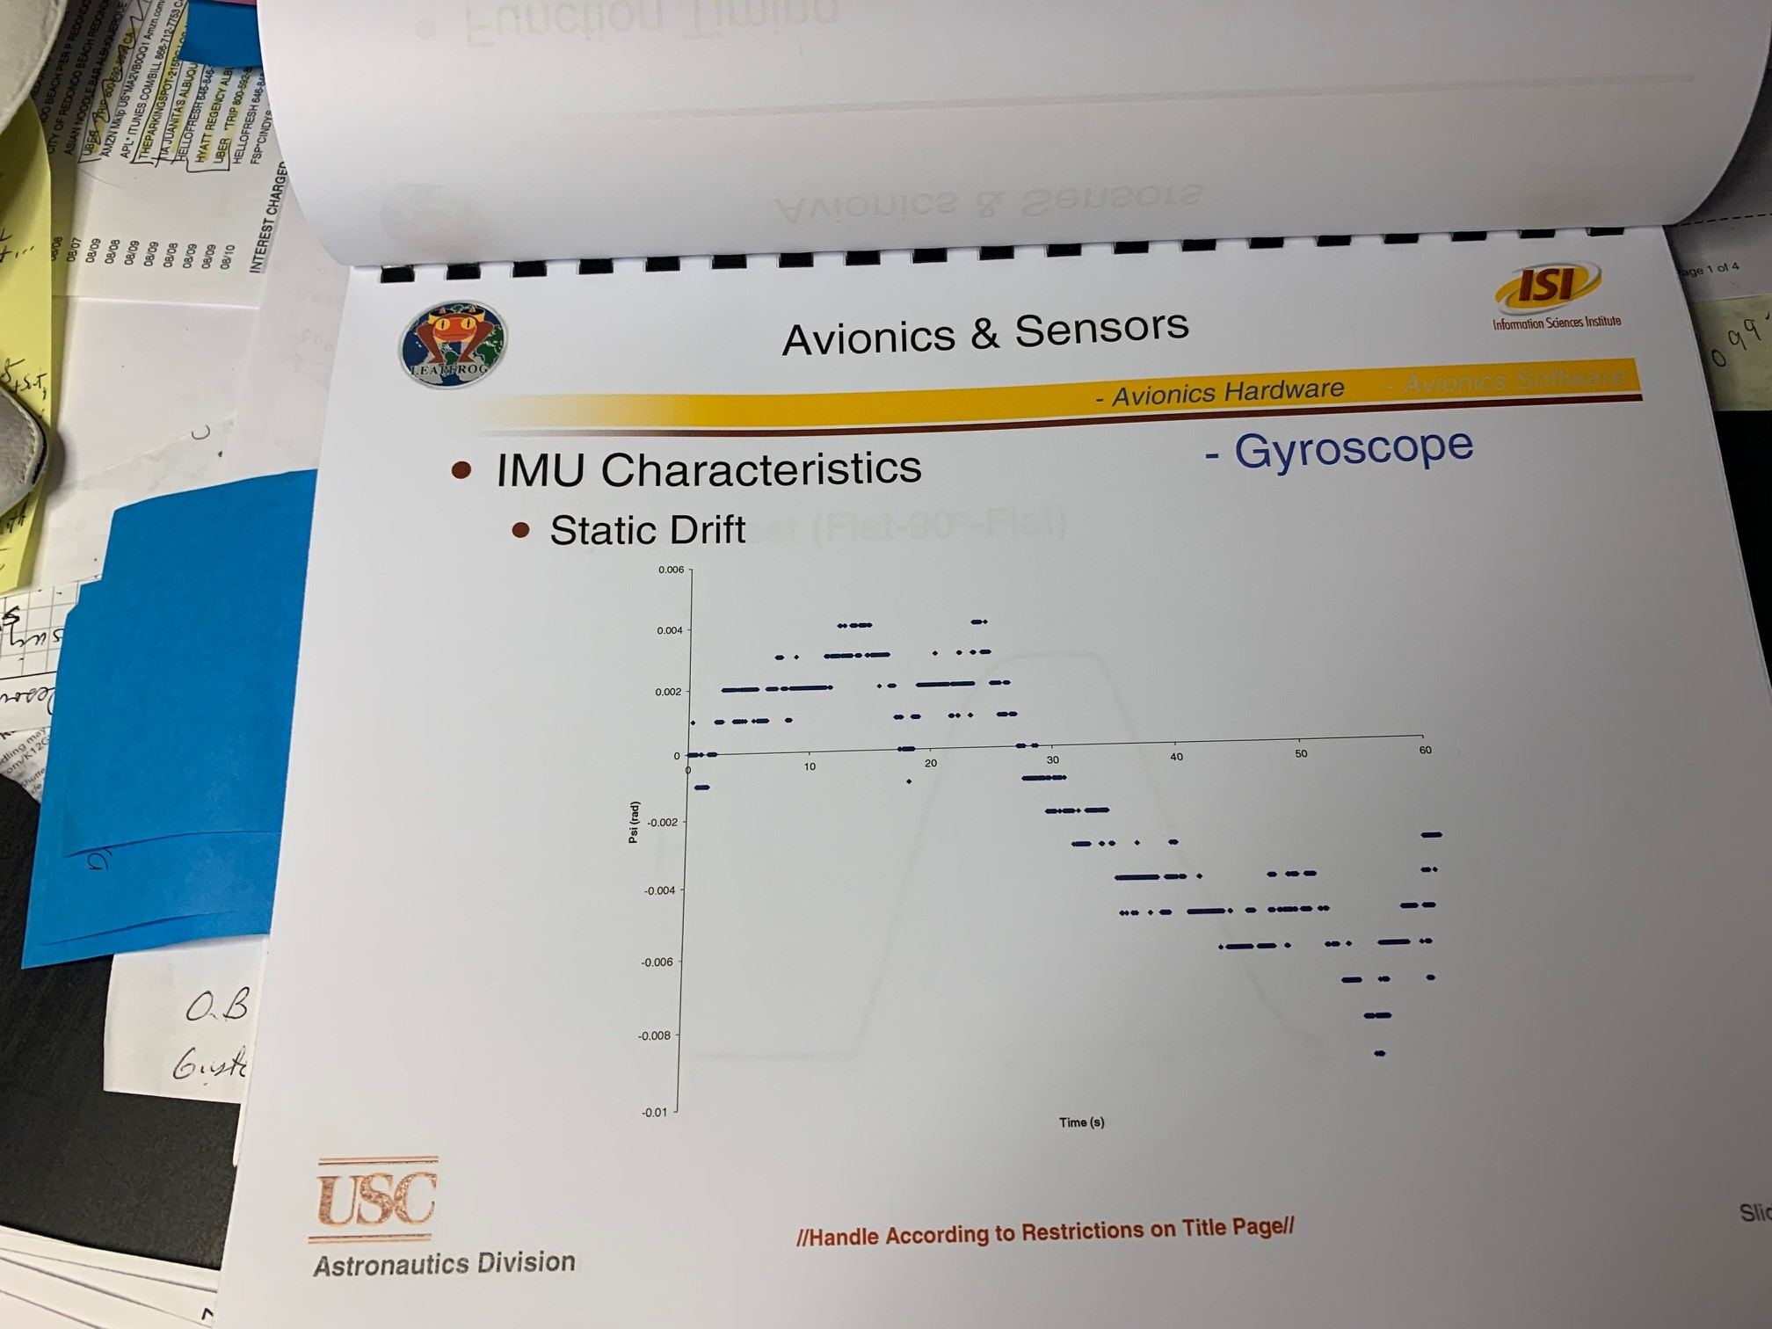
IMU Characteristics (Jose?)
Must show drift, static/dynamic displacement with accel etc

Slide 32
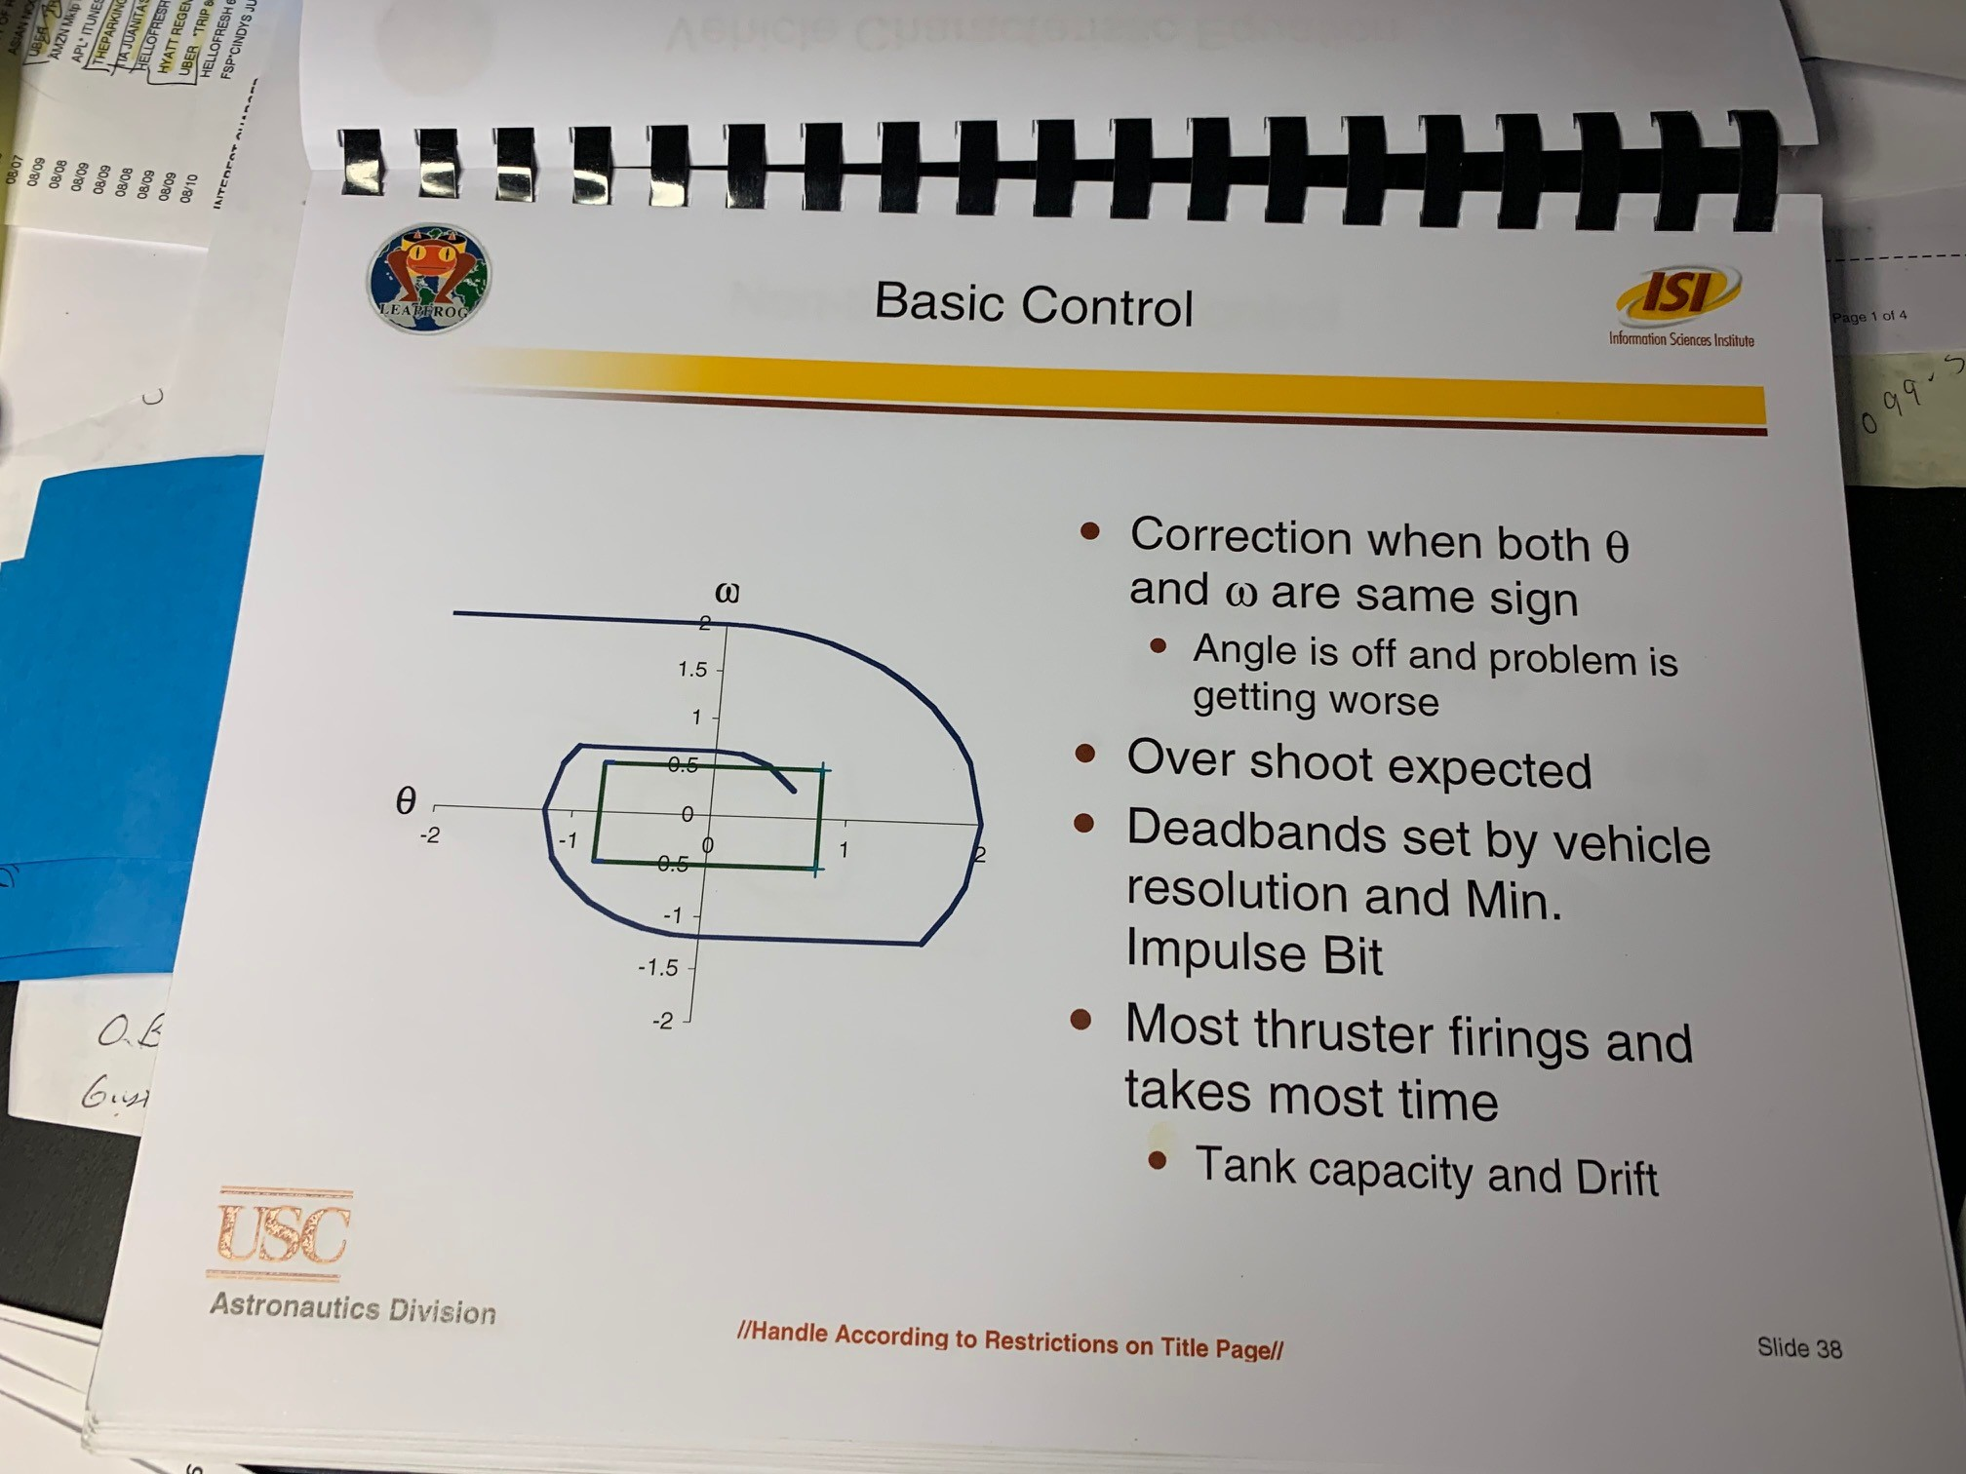
GNC and Engine Control
LEAPFROG has two methods for stability and translation
Cold Gas Attitude Control System
Thrust Vector Control for Engine
A comparison on best method to combine or separate functions was executed early on the program

Slide 33
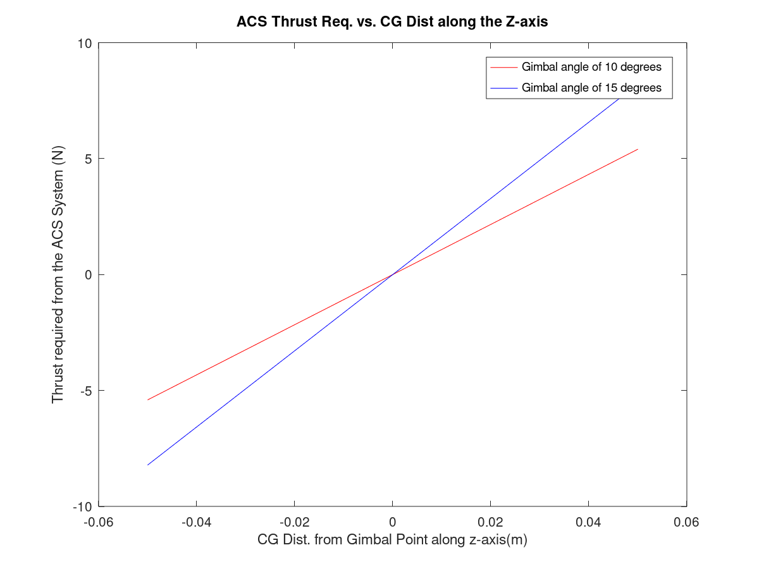
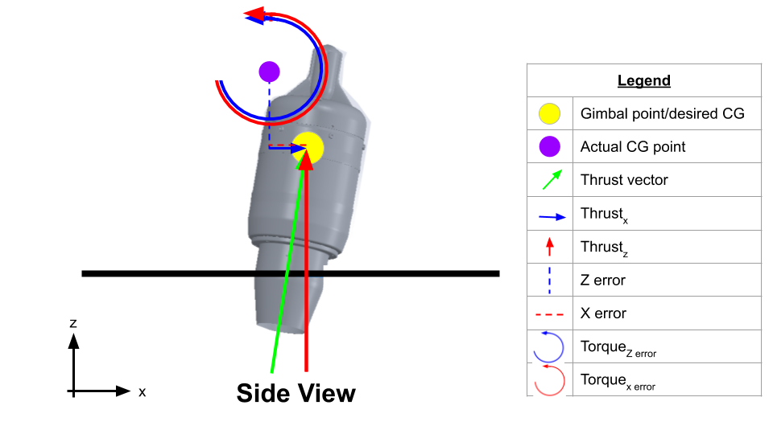
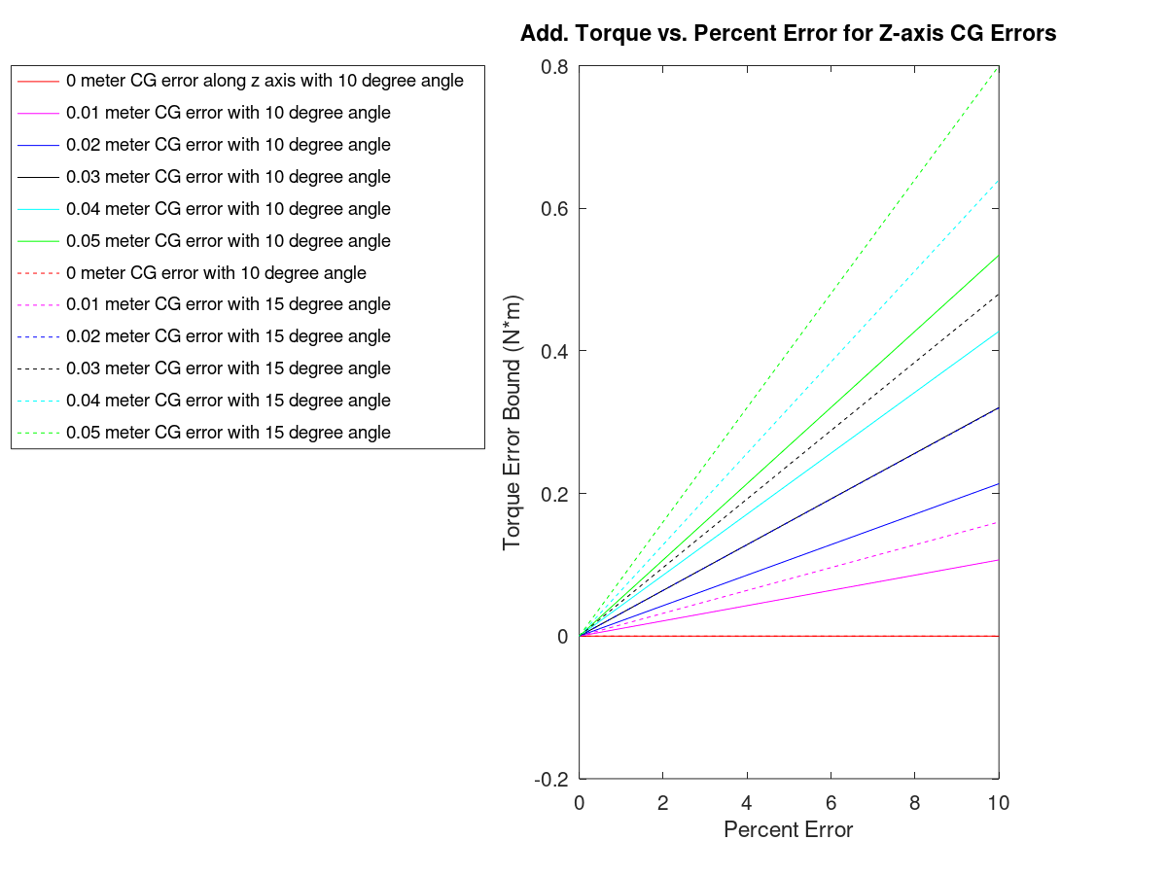
Early analysis on Engine Torque to ACS response
Link to full document: https://docs.google.com/document/d/1CP5_ekTFtuK3u4mSZqckigZ51Cf-EMv6XL89iKFO6wk/edit

Slide 34
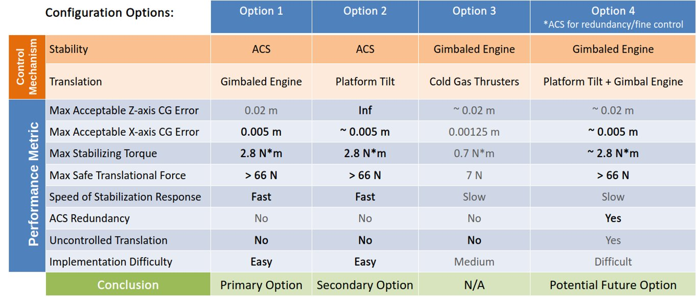
TVC/ACS configurations evaluated

Slide 35
Option X Selected: But challenges exist with two different control methods and systems (Nikita)
Plan is to use each for separate functions
Cold Gas Attitude Control System for Vehicle platform stability relative to Earth
Thrust Vector Control of Engine for Translation
Both are operated and commanded from the primary avoicis processor (Arduino)
For Student competition challenge, each team will program a PixHawk controller, that is independent from Arduino
But all commands to engine and TVC actuator go through Arduino
Key challenges:
Timing differences between what is sent from PixHawk to Arduino
Delays induced
Instability from TVC adds to ACS
Instability from ACS adds to TVC
TBD

Slide 36
Initial Test Matrix to validate from Simulation to Hardware for all GNC (Nikita)
Identify a matrix here that shows each simulation, and then a hardware test to validate it.

Slide 37
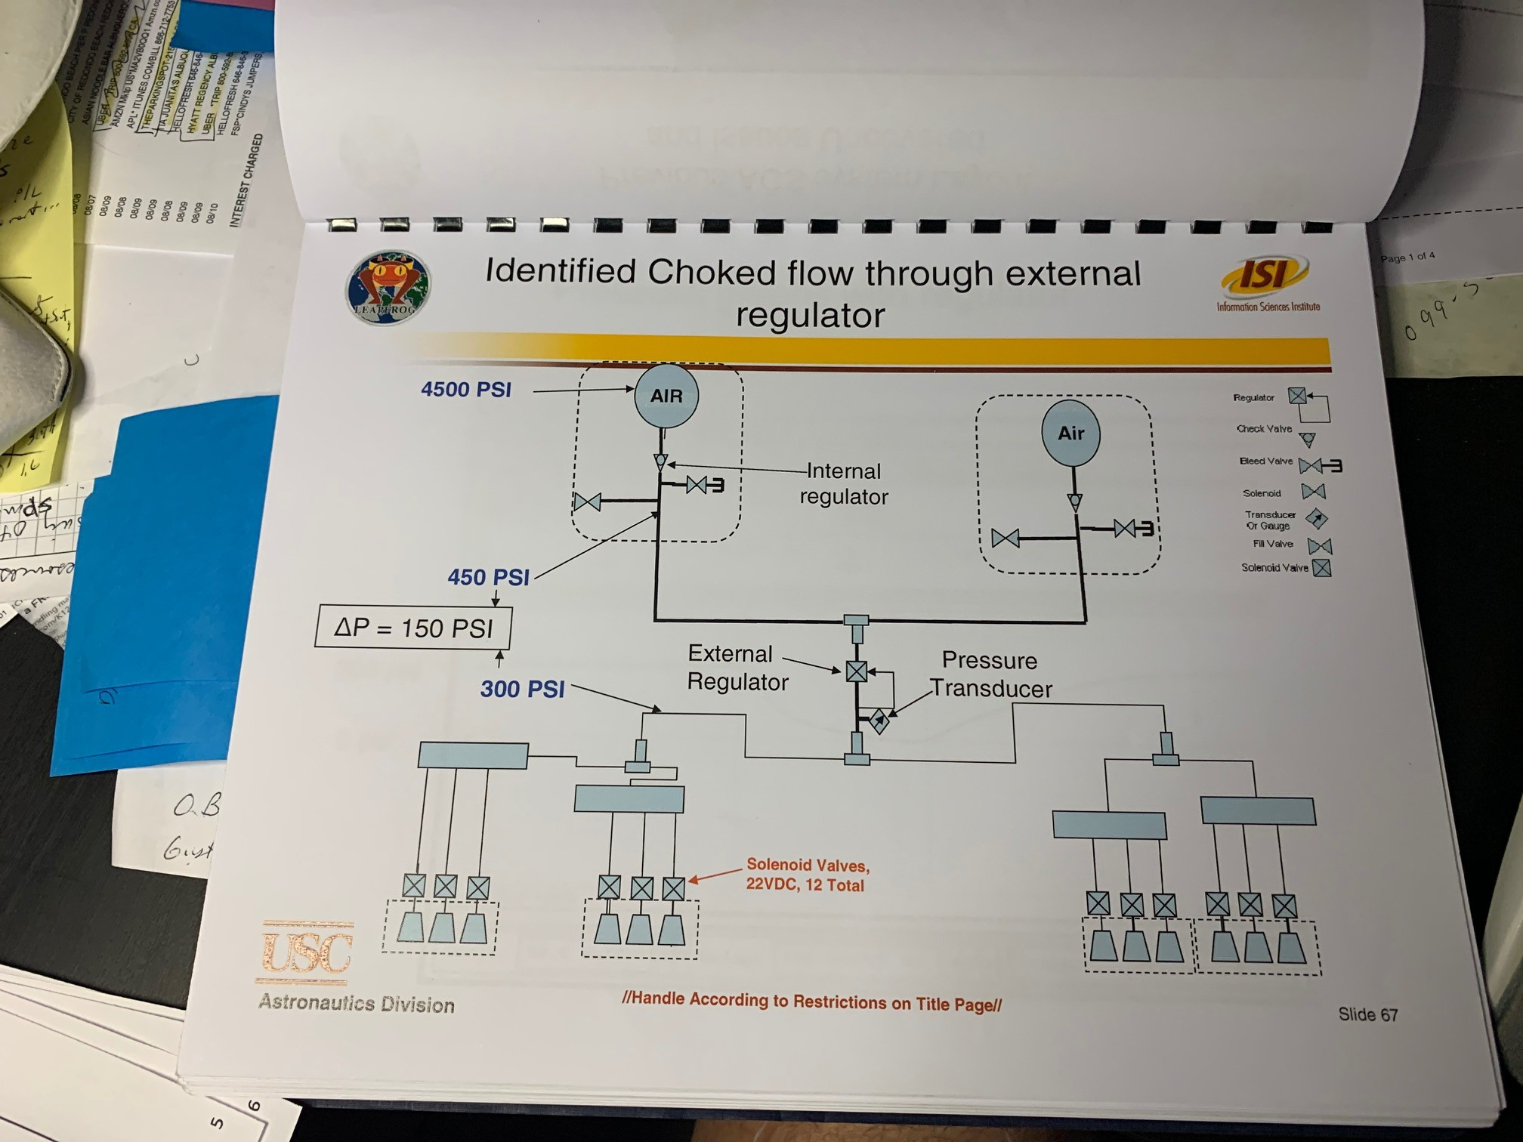
ACS Schematic (Kenya)

Slide 38
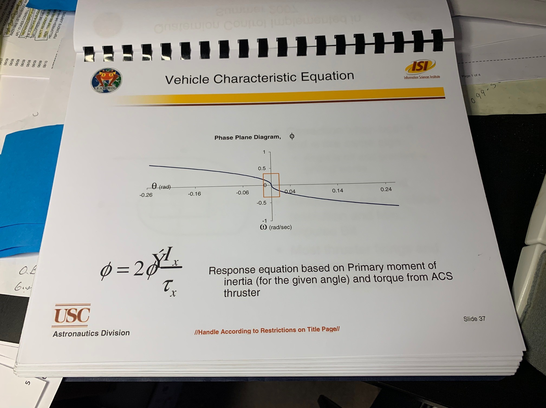
ACS Stability control based on vehicle characteristics
Kenya

Slide 39
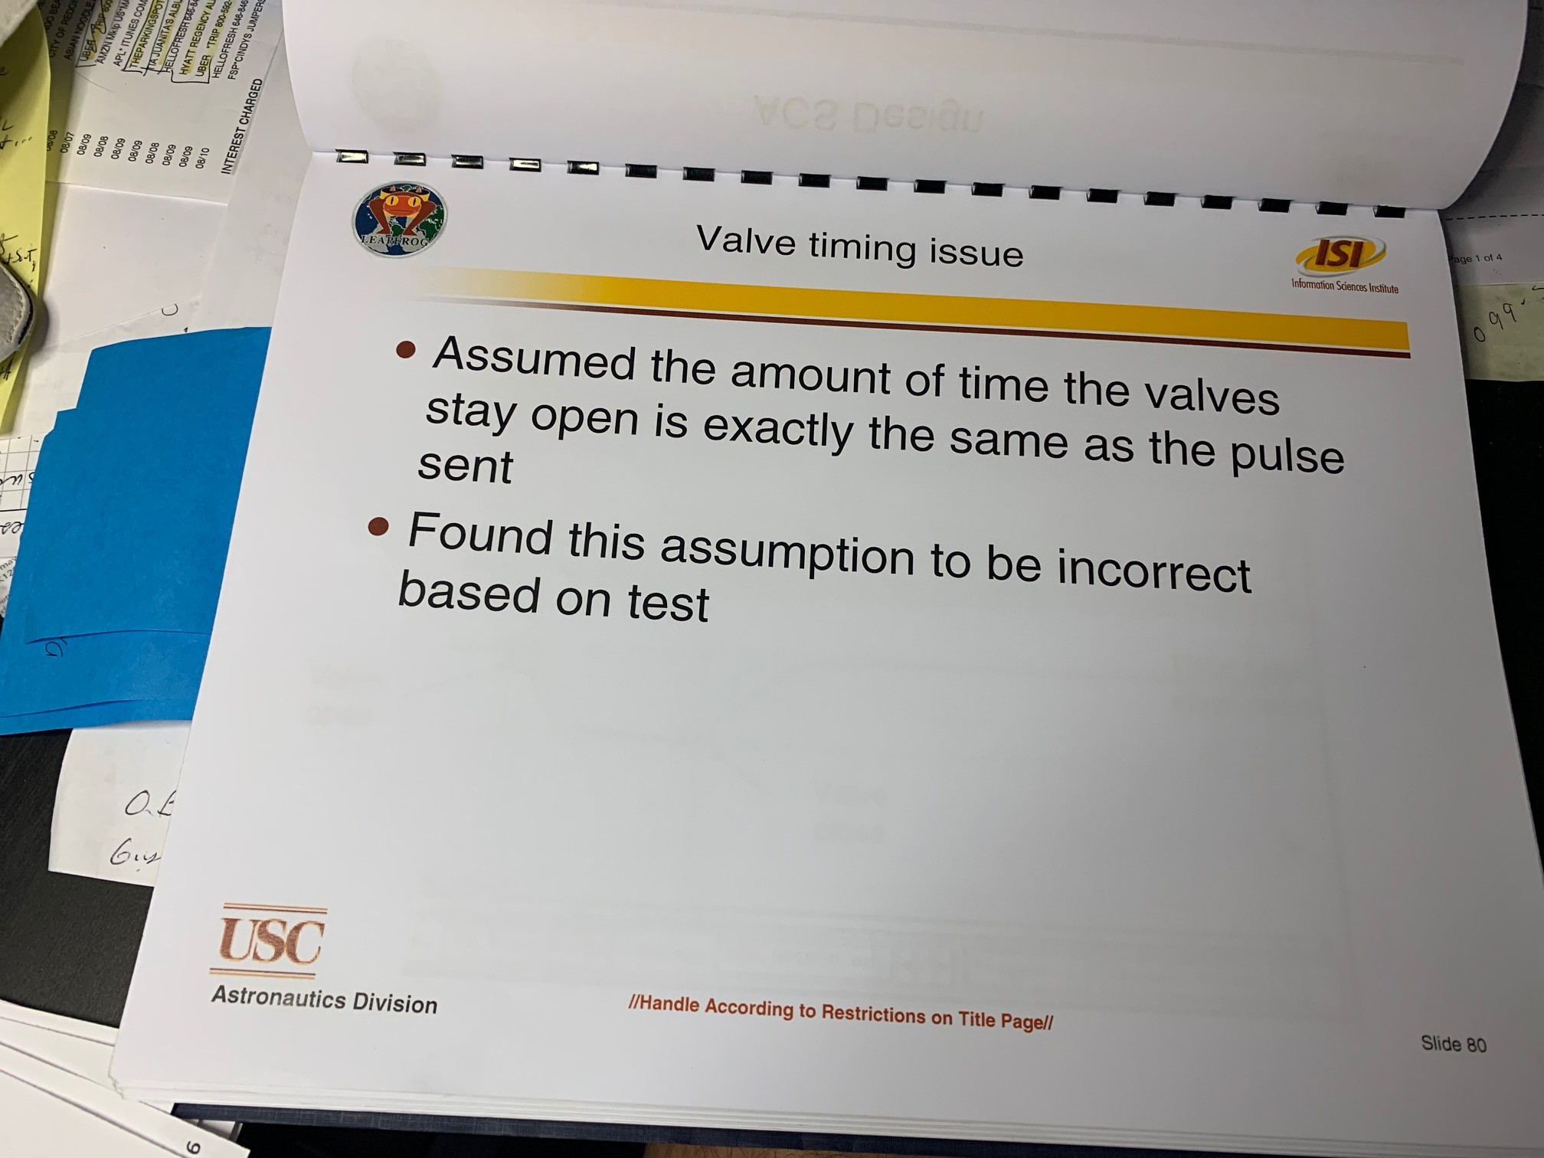
ACS Valve Response (Kenya)
Must validate valve response is fast enough and define it, as that sets up the vehicle characteristic equation in state space to show stability (ie not bang bang)

Slide 40
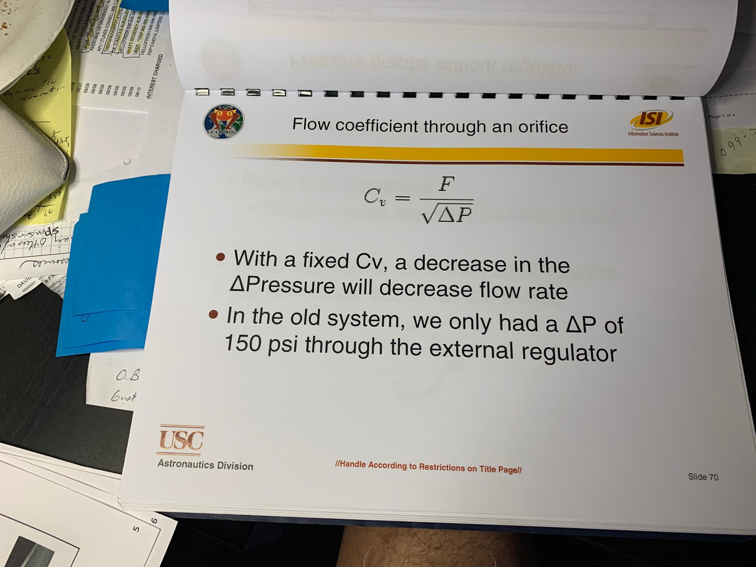
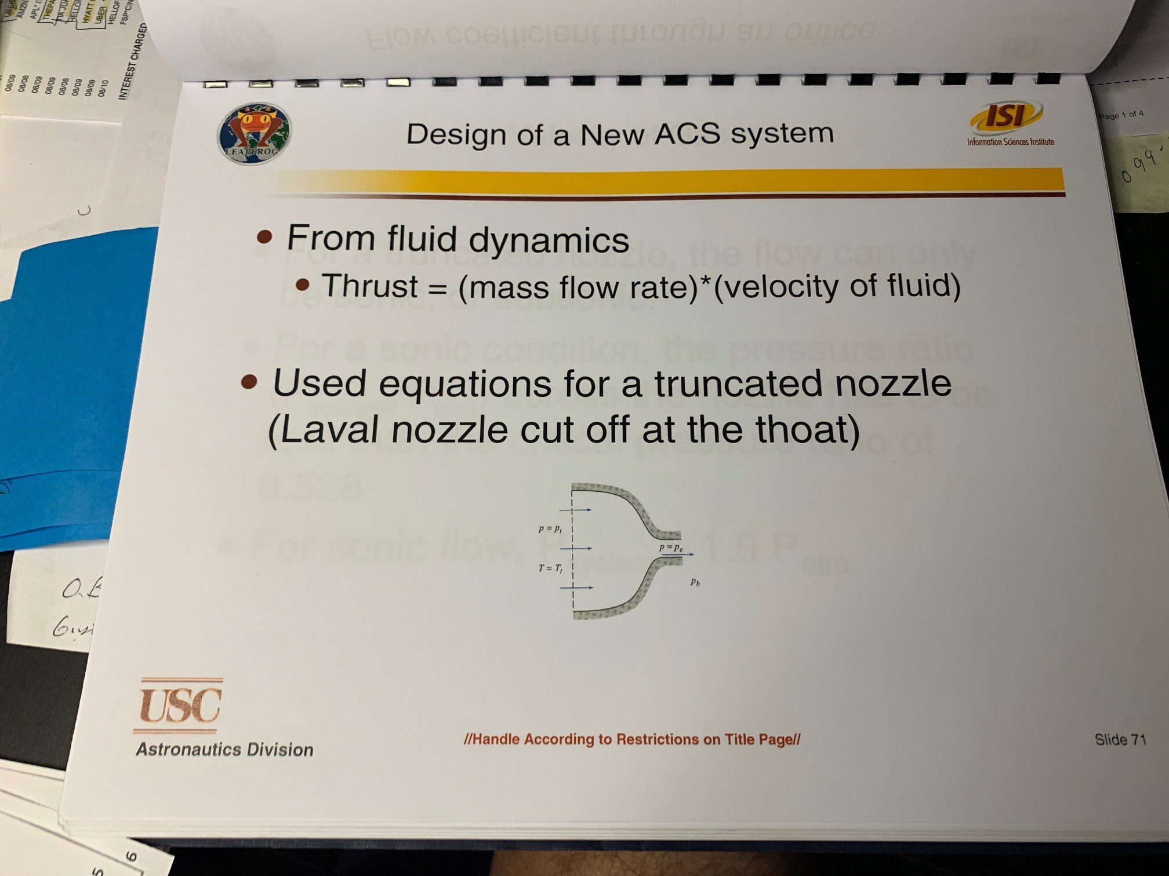
ACS Nozzle Sizing info (Kenya)
tbd

Slide 41
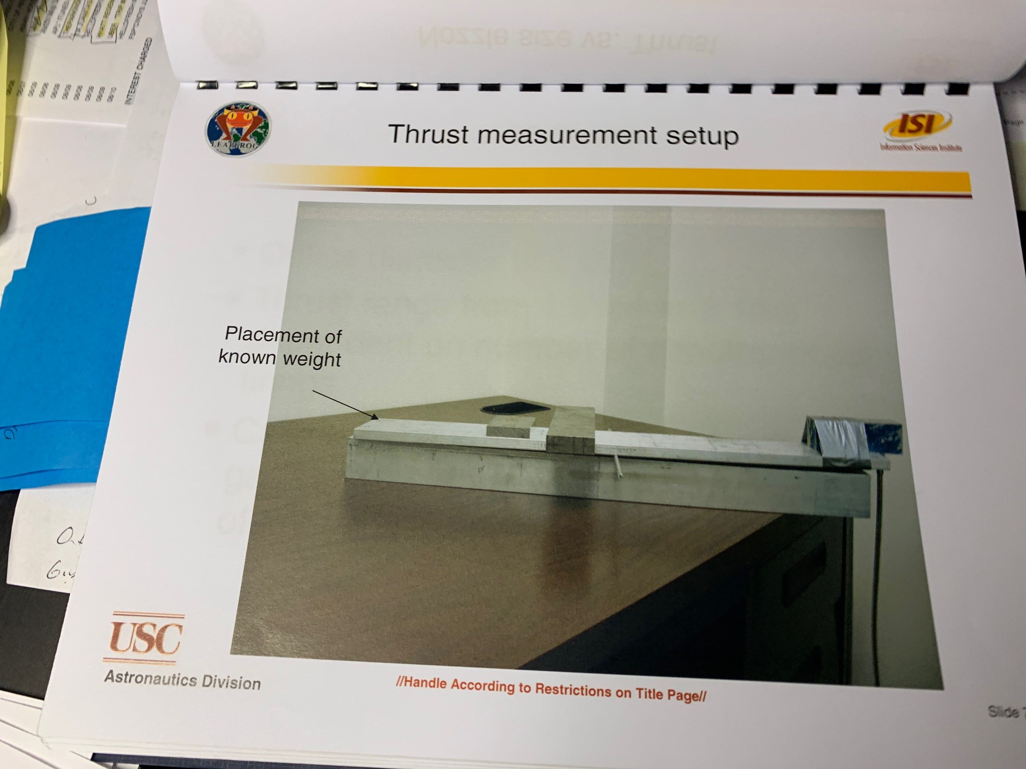
ACS Thrust Measurement setup (Kenya, show from Spring 2019)
This is old one, you have one in the lab, show that, and show results.

Slide 42
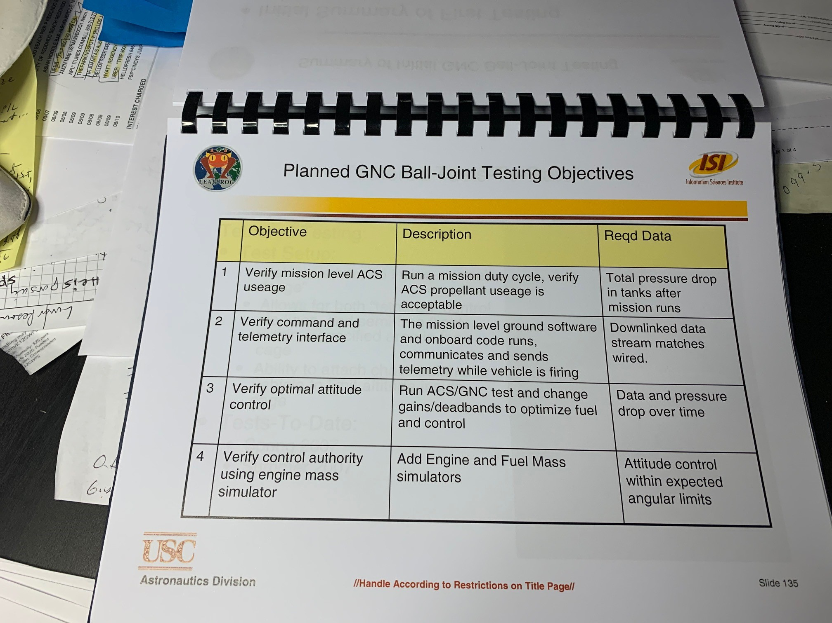
ACS Air Bearing Test Objectives to validate its function
Kenya

Slide 43
TVC Schematic (Andrew)
Show simple diagram of how the Engine and actuators etc. Same as ACS layout, but focused on gimbal system to engine

Slide 44
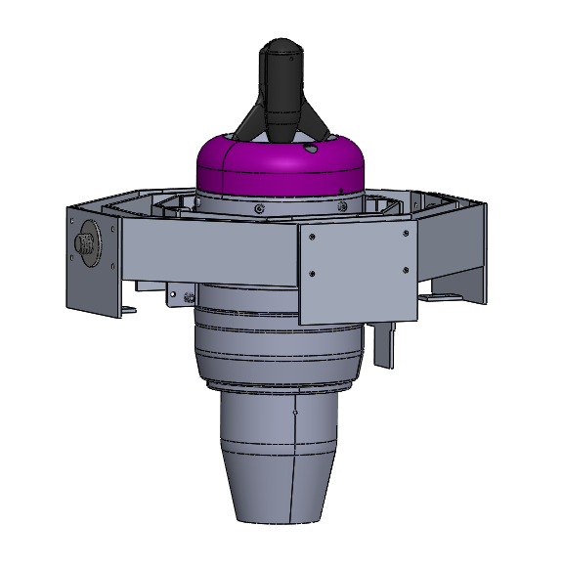
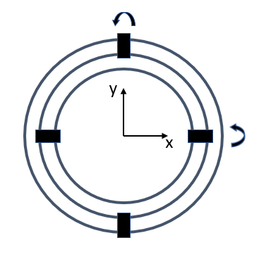
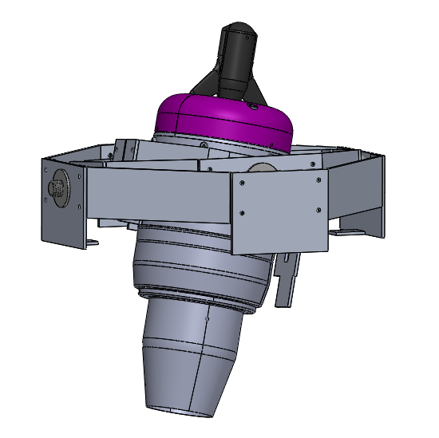
Gimbal Ring Design
3 concentric rings
Relative rotations thanks to the presence of connecting pins
Pins aligned with principal axis of inertia
VERTICAL CONFIGURATION
DISPLACED CONFIGURATION
11/10/2020
<number>
Notes:
How is the data from the MCU consumed by the Gimbal
<number>

Slide 45
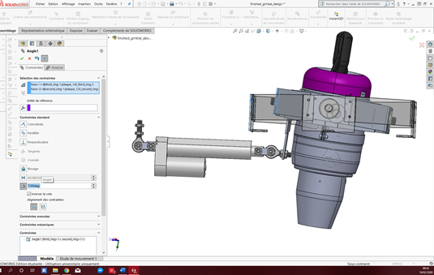
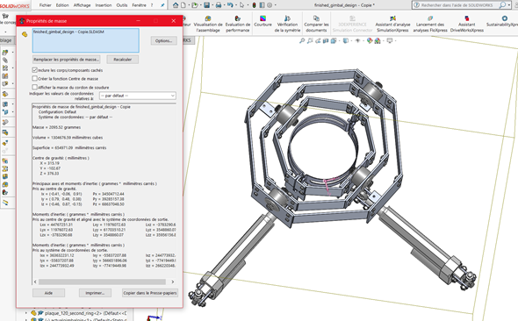
1st LEAPFROG TVC Gimbal mechanism
11/10/2020
<number>

Slide 46
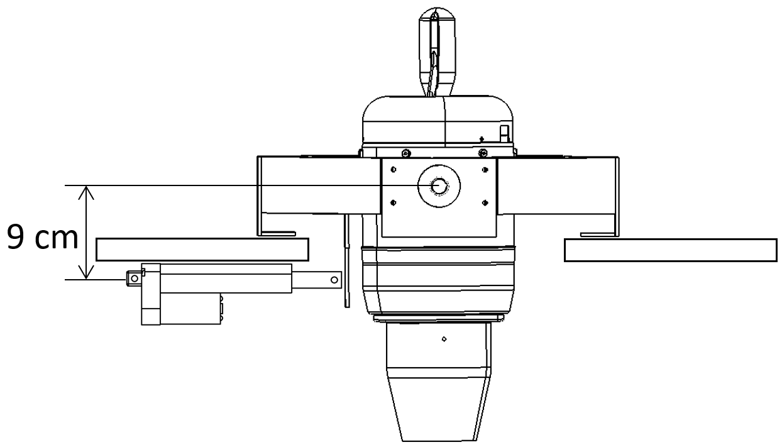
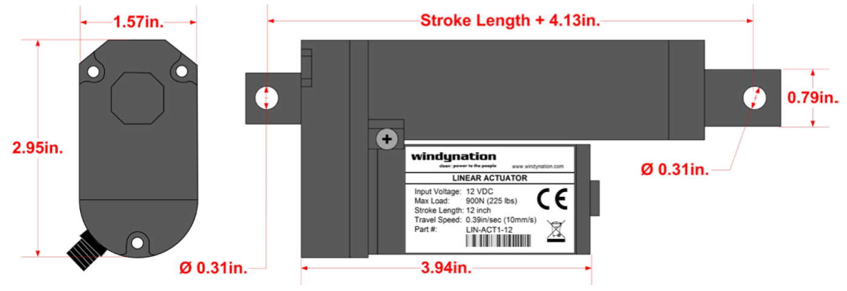
TVC System uses linear actuators
Describe gimbal system characteristics, response from actuators etc etc.
Horizontal position to maximize actuation speed
Reduced distance from the center of rotation to maximize angular displacement
Aligned with principal axis of inertia
18.4 deg/s
11/10/2020
<number>
Notes:
How is the data from the MCU consumed by the Gimbal
<number>

Slide 47
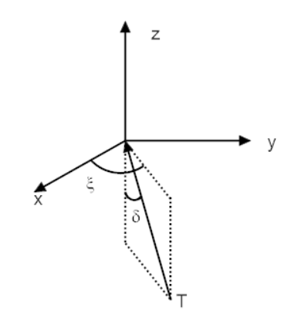
Gimbal angles defined
-90 < xi < 90
-5 < delta < 5
11/10/2020
<number>
Notes:
How is the data from the MCU consumed by the Gimbal
<number>

Slide 48
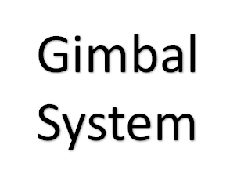
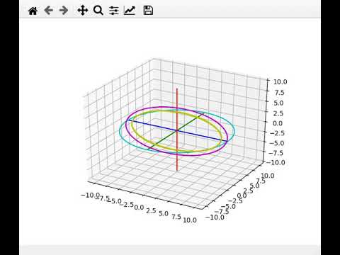
Gimbal System Prelim Analysis (Andrew update with yours?)
11/10/2020
<number>
Notes:
How is the data from the MCU consumed by the Gimbal
<number>

Slide 49
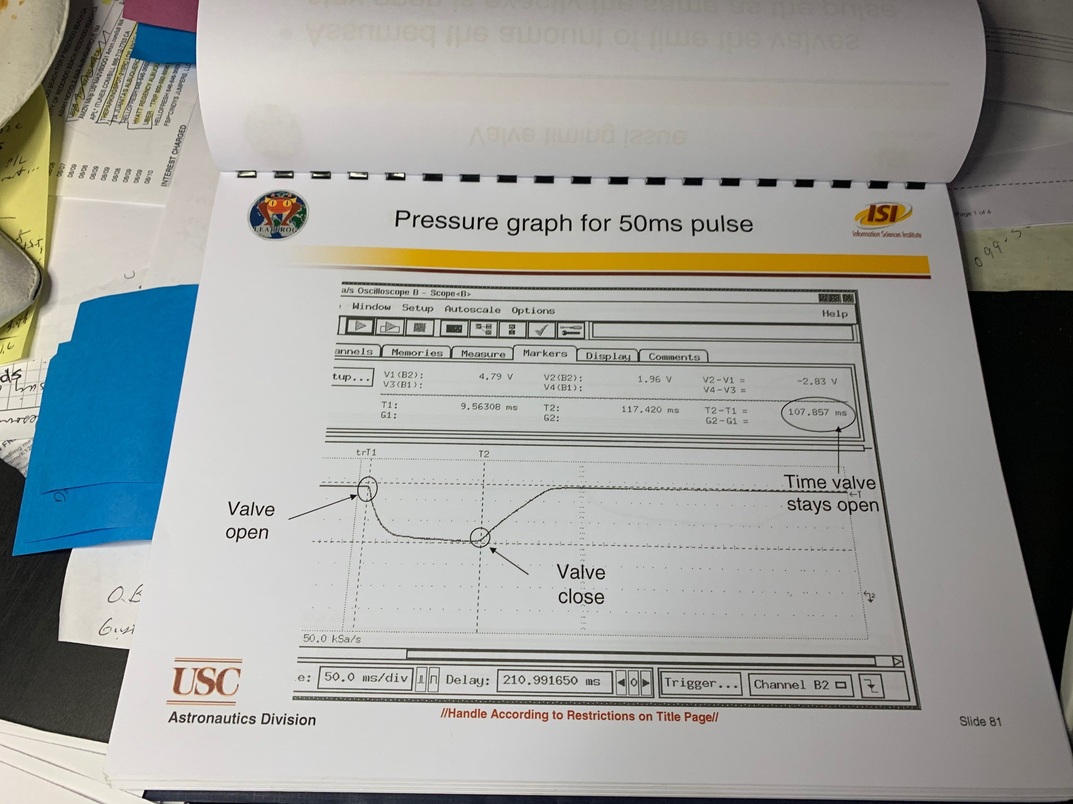
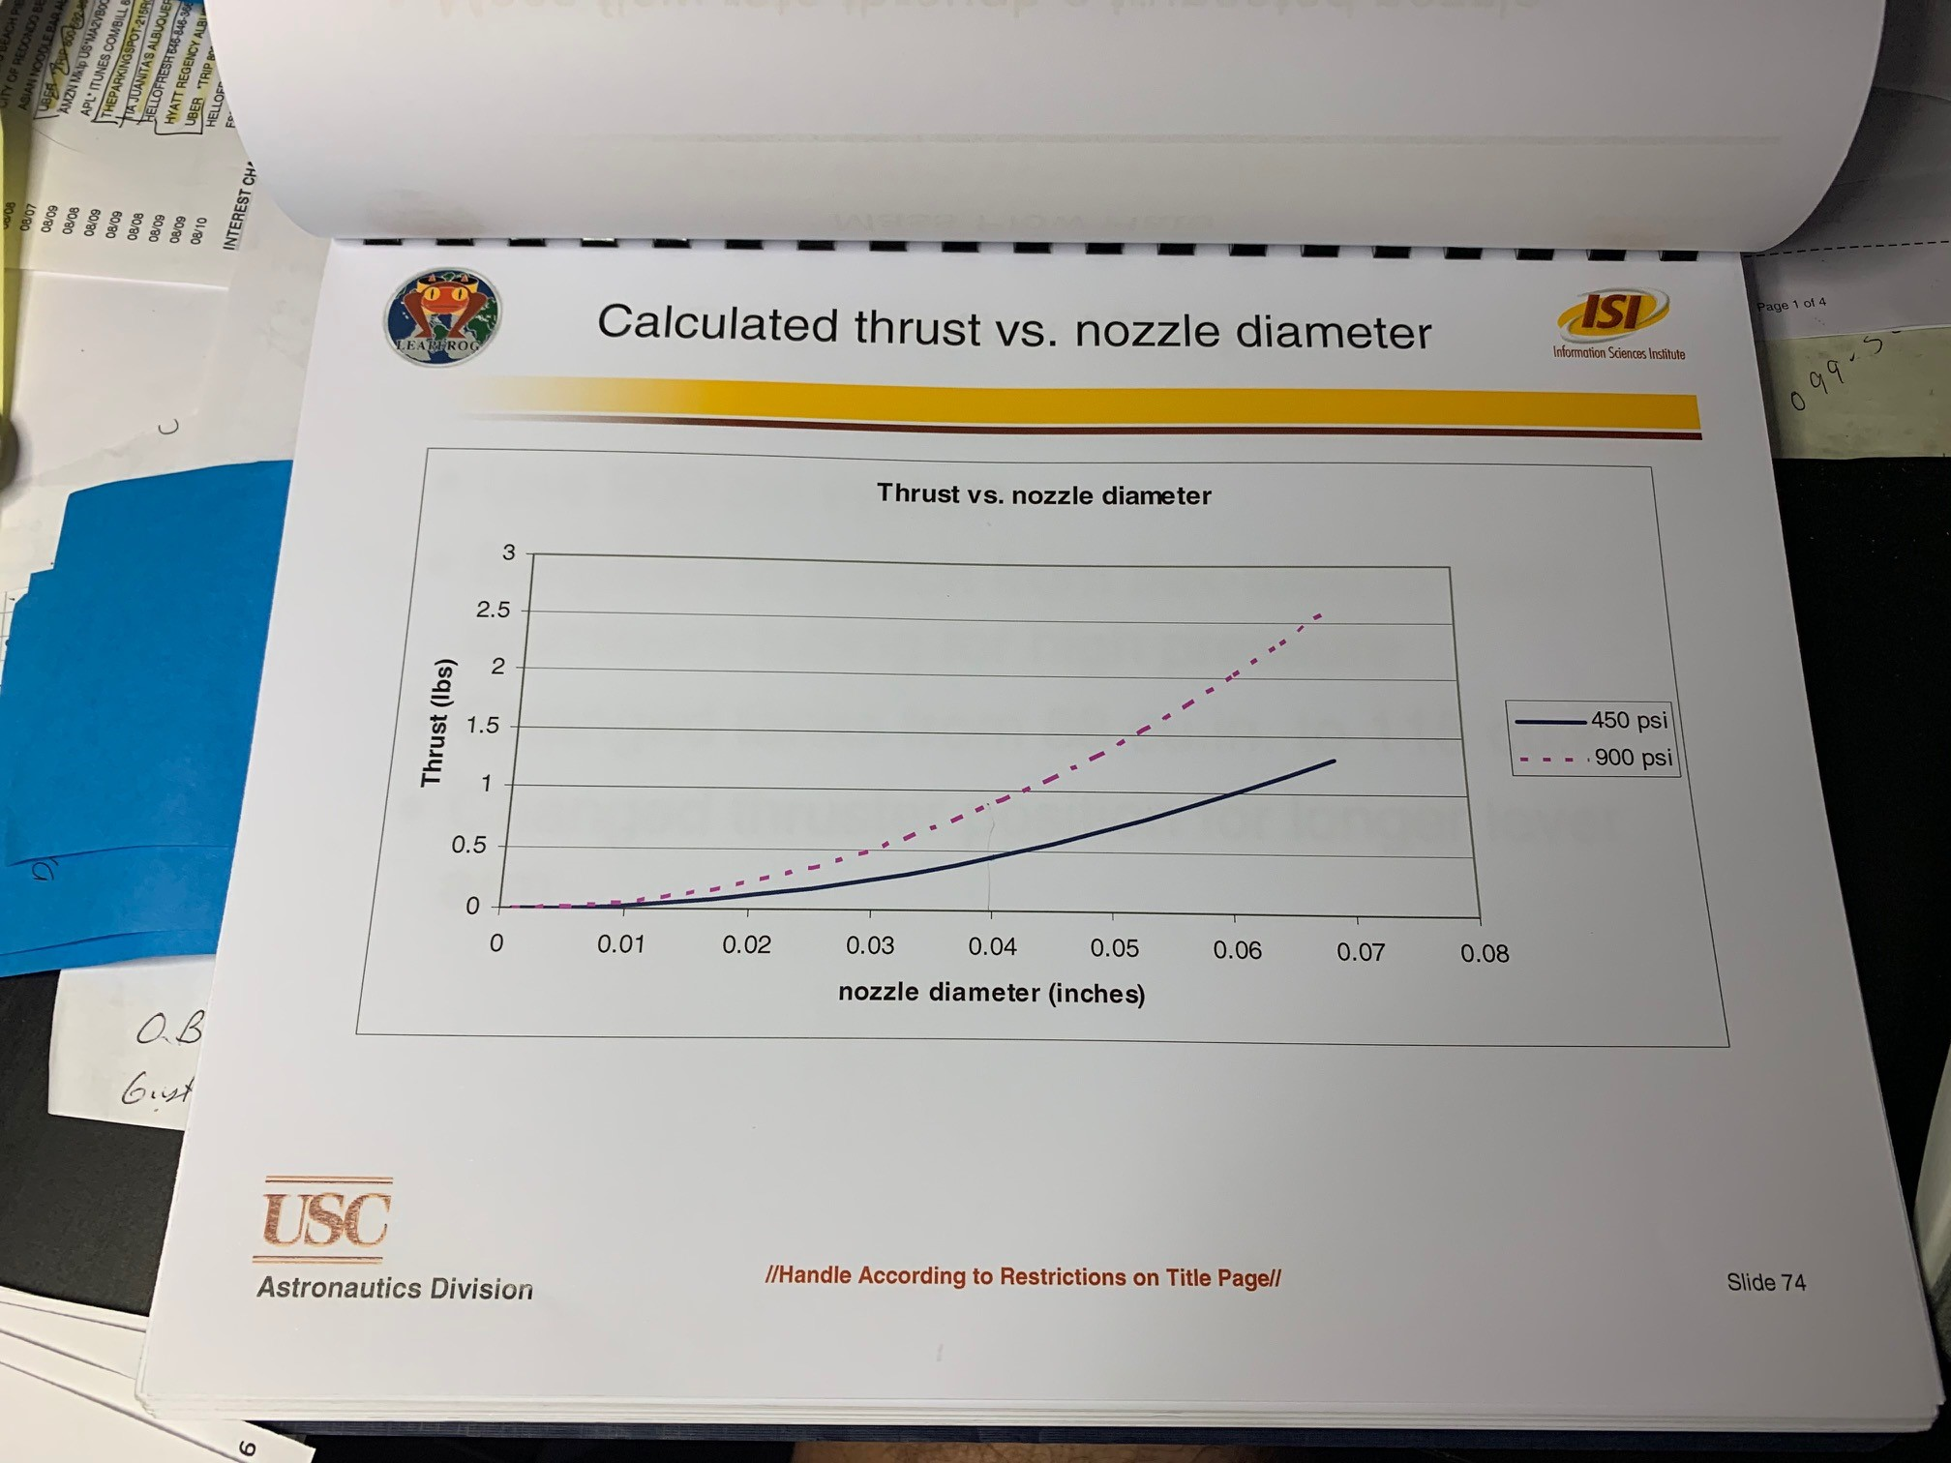
Describe engine Characteristics
Engine person and Andrew?

Slide 50

TVC Translation Motion Plans (Andrew)
This was old LEAP, show yours using TVC etc

Slide 51

TVC Control and Navigation (Andrew)
Show lateral displacement motion plan
Show altitude control plan
Etc.

Slide 52

TVC State Simulation Results (Andrew)

Slide 53
Software Plans and Architecture (Antariksh)
Competition Simulation Software: (Thanh)
Competition Flight Software: (?)
Onboard LEAPFROG Software (Antariksh)
Safety and Abort Plans
Validation Tests planned for Software functions (nominal and abort)
Ground Control Code Plan
Flight Operations Scheduler

Slide 54
Software Details- Safety and Abort Clauses
Safety and Abort Clauses
Three classes of Abort Commands
Subsystem Test Terminate
To abort an individual subsystem preflight test. The test is aborted as soon as possible (based on preservation of system).
Mission Abort Command
In this class, a vehicle can be either sent an Abort Command from Ground, or the GNC can decide that it needs to Abort.
The vehicle aborts the normal profile navigation, the attitude is fixed to normal, and the engine goes to AbortRPM.
Mission Emergency Abort
In this mode all operations are suspended immediately, including shut down of all Thrusters and emergency shutdown of the Jet Engine.

Slide 55
Initial Test Validation Matrix for Software and Avionics Control

Slide 56

Software Architecture Pseudo-Code Diagram

Slide 57


Software Architecture (cont.)
Mission Code
Initialize GNC variables
Initialize Avionics Variables
Enable Timer Interrupts
Read Sensors
Convert Sensor Values
In_Flight = GNC_Luna()
Check In_Flight
Disable Timer Interrupts
Jet_Send
RETURN TO MAIN MENU
ACS_Send

Slide 58
Ground Command Abort Sequences
Command/Auto | Command Pressed/Reason | Effect on Engine | Effect on controller | Effect on ACS
Emergency shutdown/ | D/ | Full shut off | None | Shutoff
Engine Idle/ | C/ | Idle | none | Off
Z toggle/ | Z/ | No change | Z controller removed, no effect on GNC | Stays On
Flight Abort/ | A/ | RPM fixed to value corresponding to thrust just below weight | Z-off, GNC is on | ACS is on
/D | Angle exceeded> +/-15degree | Full shut off | None | Shutoff
/A | Altitude > 6 m | RPM fixed to value | Z-off, GNC is on | Acs is on
/D | Flight time exceeded> t secs | Full shut off | None | Shutoff
Notes:
<number>

Slide 59
Fault Probabilities and Scenarios
Scenarios | Reason | Problems | Abort Sequence
Flight above 6 meters | Manual; engine keeps firing | Escapes net boundary | Flight Abort
Flight time > t seconds | Manual; engine keeps firing | Overheating | Emergency
Roll, Pitch > +/-15 degrees | Wind; misfiring thrusters; altimeter misreading | Tips over | Emergency
Rabbit Dies | Electrical misfires; batteries die | Controls inputs; engine may still fire | Emergency
Engine Fails | Air in fuel; electrical misfire; pump malfunction; dust | Coughs; fire damage; stalls completely | Flight Abort or Emergency
Altitude Control System | Batteries die; wires disconnect | Stabilizing thrusters won't work properly | Flight Abort
Z-controller Fails | Altimeter misreading; disconnection | Begins rotating irrationally | Flight Abort
Ground Comp Malfunctions/Dies | Battery; Bluetooth malfunction | Craft is running on auto | No sequence
Power Fails Non-uniformly | Batteries die; wires disconnect | See Rabbit, Engine, Controller dies | Flight Abort or Emergency
Power Fails Uniformly | Batteries die; wires disconnect | Machine drops to ground as engine stops | Flight Abort or Emergency
Notes:
<number>

Slide 60
Abort and Mission Variables would be programmed into onboard Avionics prior to flight
Notes:
<number>

Slide 61

Show a simple integration and build and test flow (Michael)
Notes:
<number>

Slide 62

Need to identify key risk areas and show we are mitigating them (Daniel/Nikita/Dave et al)
Notes:
<number>

